Slide 1
What are the emerging infectious disease threats to MPHO?
Dragoslav Domanović, MD, PhD,
European Blood Alliance
14-15 Nov 2024, Rome, Italy

Slide 2
DOI & Presentation outline
DOI
I have no conflict of interest to declare.
Presentation outline
European blood alliance
Emerging infectious diseases
Selected emerging infectious diseases and MPHO safety

Slide 3

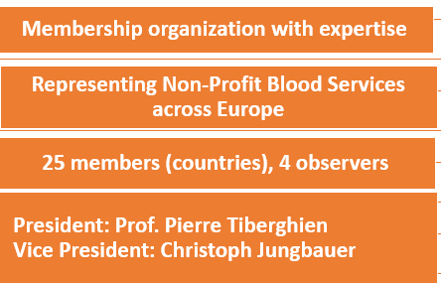
European Blood Alliance
EBA Mission
To contribute to the availability, quality, safety and cost-effectiveness of the blood and tissue supply for the citizens of Europe by developing and maintaining an efficient and strong collaboration amongst European blood and tissue services.
To increase public and professional awareness of voluntary and non-remunerated donation of blood and blood components, and of preparation of blood components as an indispensable therapeutic means to help patients.
To assist European blood establishments to continuously improve their performance, based on scientific and ethical principles for the benefit of patients.

Slide 4
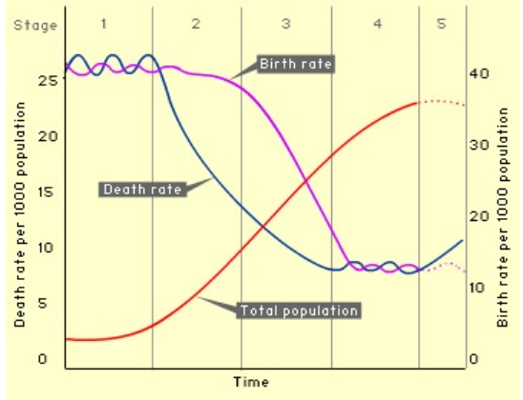
Epidemiologic transition model
Emerging and reemerging infections & epidemiology of population change
Demographic transition
Epidemiologic transition
Pestilence & Famine
Receding Pandemics
Degenerative & Man-Made Diseases
Delayed degenerative diseases & Emerging & Reemerging Infections
      Basic models
      Western model
      Accelerated model
      Contemporary (Delayed) model
Omran AR. The epidemiologic transition: a theory of the epidemiology of population change. 1971. Milbank Q. 2005;83(4):731-57.

Slide 5
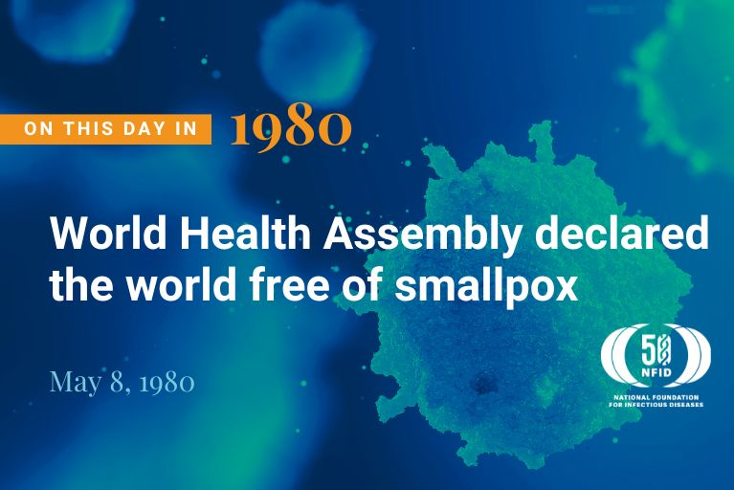
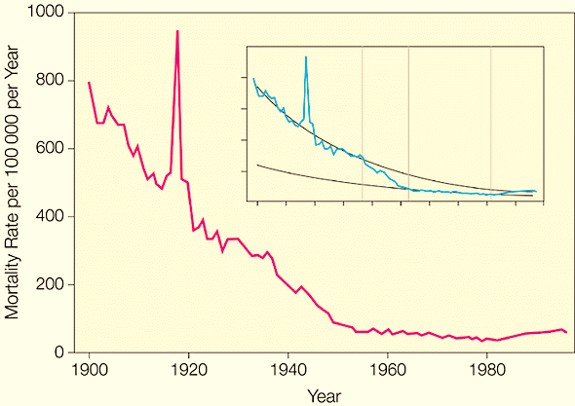
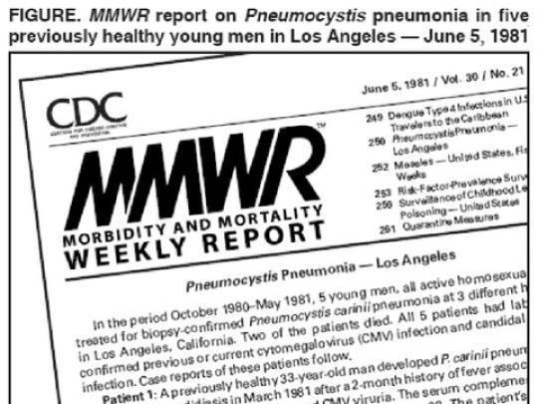
Infectious diseases over the 20th century
Decreased infectious disease mortality rate
Crude Infectious Disease Mortality Rate in the US from 1900 - 1996
Armstrong GL, Conn LA, Pinner RW. Trends in Infectious Disease Mortality in the United States During the 20th Century. JAMA. 1999;281(1):61–66.

Slide 6
Lessons learned from HIV - A paradigm shift
Precautionary principle
  “for situations of scientific uncertainty, the possibility of risk should be taken into account in the absence of proof to the contrary” and that “measures need to be taken to face potential serious risks”
Rapid implementation of laboratory screening
  Shortening the time from the discovery of the causative agent to the development of the screening test (3 years for HIV, several week weeks for SARS-CoV-2)
Surveillance & vigilance (hemovigilance and biovigilance)
  Early recognition and estimation of potential transmissibility through MPHO, active surveillance through seroepidemiological studies or specific sources
  Surveillance of Adverse reactions and events
Traceability
  the ability to trace each blood, C&T and organs from the donor to its final destination, whether this is a recipient, a manufacturer of medicinal products or disposal, and vice versa.
Regulatory oversight
  National competent authorities, FDA,
Pathogen reduction/inactivation

Slide 7
Traceability of MPHO
Mitigation of MPHO-transmitted diseases
Identify the current and any prior donations from the donor;
Locate and quarantine any products in inventory from the current donation and any prior donations;
Identify the recipient(s) of the product(s) of the current donation, as well as recipients of previous donations, and notify their physicians. Early identification and treatment of patients exposed to MPHO-transmitted diseases may allow mitigation of the disease in the recipient;
Exclude the donor from further donations;
Encourage the donor to consult a doctor for investigation and treatment of the disease

Slide 8
Transfusion-transmitted infections
Haemovigilance data on TTIs in the last two decades
Country | Period | Units transfused | SAR | TTI | TTI/10e6
EU¹ | 2018, 2019,2021 | 56,453,542 | 7,977 | 74 | 1.3/10e6
USA² | 2010 - 2016 | 7,917,786 | - | 54 | 6.8/10e6
Canada³ | 2006-2012 | 8,175,504 | 3,957 | 33 | 4.0/10e6
Australia⁴ | 2015-2020 | - | 3,015 | 48 | 2.0/10e6 (RBC)
ISTARE/IHN⁵ | 2012-2015 | 107,778,290 (issued) | 23,131 | 284 | 2.0/10e6
¹ European Commission, Annual reports of SARE 2018, 2019,2021
² Haass KA, Sapiano MRP, Savinkina A, Kuehnert MJ, Basavaraju SV. Transfusion-Transmitted Infections Reported to the National Healthcare Safety Network Hemovigilance Module. Transfus Med Rev. 2019;33(2):84-91.
³ https://www.canada.ca/en/public-health/services/surveillance/blood-safety-contribution-program/transfusion-transmitted-injuries-surveillance-system.html
⁴www.blood.gov.au/haemovigilance-reporting
⁵ Politis C, et all. Adverse reactions following transfusion of blood components, with a focus on some rare reactions: Reports to the International Haemovigilance Network Database (ISTARE) in 2012–2016, Transfusion Clinique et Biologique, Volume 29, Issue 3, 2022, p 243-249.

Slide 9
Transplantation-transmitted infections
Cells and Tissues
Country | Period | C&T Recipients | SAR | TI | TI/10e5
EU* | 2018 | 361418 | 232 | 16 | 4.4/10e5
 | 2019 | 298897 | 306 | 27 | 9.0/10e5
 | 2020 | 316418 | 350 | 8 | 2.5/10e5
 | 2021 | 318467 | 326 | 12 | 3.8/10e5
* European Commission, Annual reports of SARE 2018 -2021
Organs
Country | Period | Organs transplanted | Donors with P/P infections | Recipients received transplants from donors with P/P infections | Recipients with infection transmission | DDID %
Germany* | 2016-2022 | 8,519 | 30 | 112 | 45 | 0.52%
* Böhler K, Rahmel A, Barreiros AP. Vigilance Data in Organ Donation and Solid Organ Transplantation in Germany: Six Years of Experience 2016-2022. Transpl Int. 2023 Sep 4;36:11610.

Slide 10
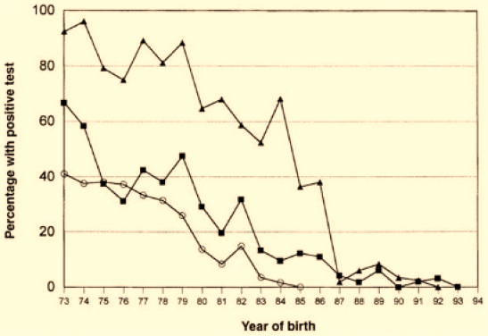
Transmission of infections via PDMPs
Prevalence of blood-borne infections in haemophilic birth cohorts in the United States
. HBV (▪), HCV(Inline graphic) and HIV-1 (Inline graphic). The proportion was zero for HIV after 1984, for HCV after 1992, and for HBV after 1993. From Soucie et al. 2001.

Slide 11
Infectious disease threats to MPHO
  Serious consequences to health
  Public health significance
  Public perception
  Continuous threat
“Existing pathogens” (HBV, HBC, HIV, Lues, malaria…)
Risk known and specific intervention developed. Transmission via transfusion may occur due to:
  Failure of a screening test to detect a pathogen in donation/donor
          the “diagnostic window”
          chronic carrier states
          atypical genetic variants of the pathogen and
          laboratory errors
  Failure to recognize that a particular infection is prevalent in a donor population
  Pathogen reduction failure
Emerging/re-emerging infections ( ZIKV, SARS-CoV-2)
Risk unknown and specific interventions not developed, Transmission via MPHO may occur due to:
  Inability to detect an infection in a donor population or inactivate/remove the pathogen from donated blood

Slide 12
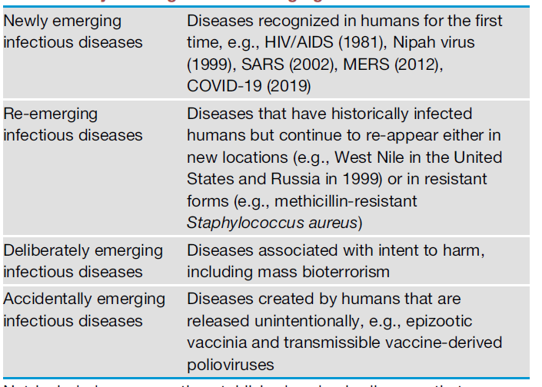
Definition and Major Categories of EIDs
EID - infections that have newly appeared in a population or have existed but are rapidly increasing in incidence or geographic range

Slide 13
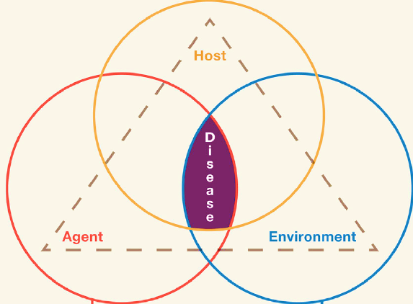
EID drivers
globalization and environmental change
social and demographic drivers
public health system drivers
human behaviour, urbanization, agriculture,
animal husbandry

Slide 14
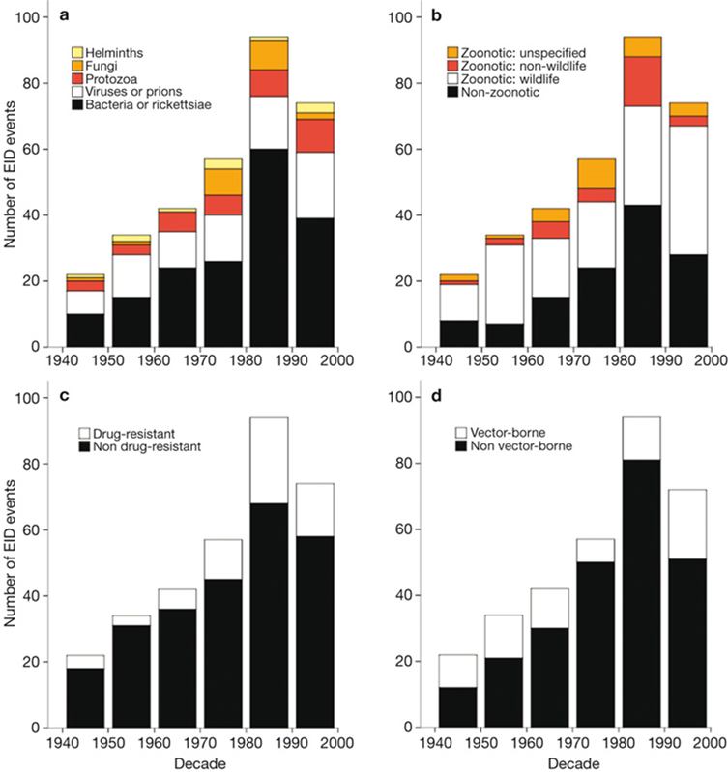
Global trends in emerging infectious diseases
335 EID 'events' that occurred between 1940 and 2004;
Zoonoses 60.3% (wildlife origin 71.8%);
54.3% of EID events are caused by bacteria or rickettsia, reflecting a high number of drug-resistant microbes;
Correlate with socio-economic, environmental, climatic, and ecological factors; - EID hotspots
Jones KE et al. Global trends in emerging infectious diseases. Nature 451, 990-993, 2008

Slide 15
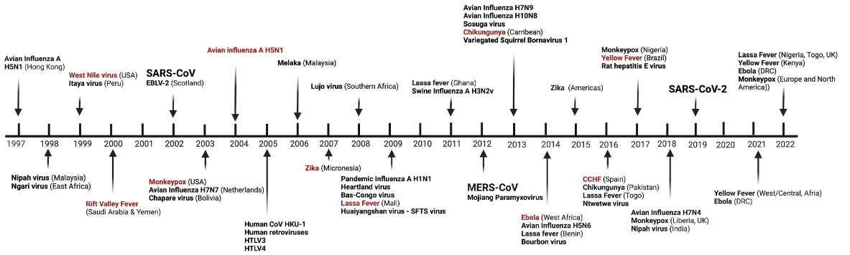
Emergence reemergence of viral infections
Timeline from 1997 to the 2022
Keusch, Gerald T., et al. "Pandemic Origins and a One Health Approach to Preparedness and Prevention: Solutions Based on SARS-CoV-2 and Other RNA Viruses." Proceedings of the National Academy of Sciences, vol. 119, no. 42, 2022, p. e2202871119, https://doi.org/10.1073/pnas.2202871119.

Slide 16
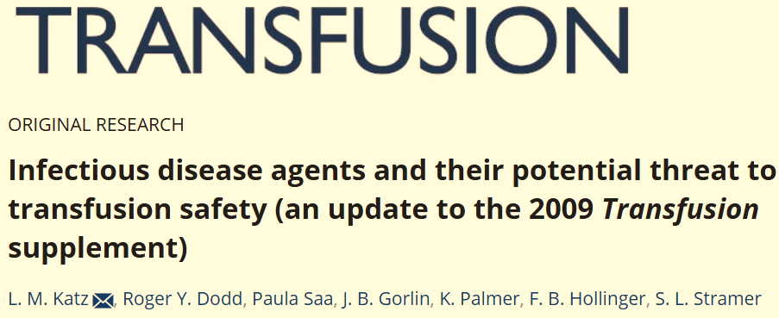

Assessing EID Risks to MPHO safety
Biggerstaff-Petersen risk assessment model
B. Biggerstaff, L. Petersen, Estimated risk of West Nile Virus transmission through blood
transfusion during an epidemic in Queens, New York City. Transfusion Volume 42, Issue 8,
pages 1019–1026, August 2002
The European Up-front Risk Assessment Tool - EUFRAT - 2011
http://eufrattool.ecdc.europa.eu/
Prion Agents (3)
Viral Agents (48)
Bacterial Agents (10)
Other Bacterial Agents (6)
Protozoan Agents &Nematode Agents (5)
Malaria Fact Sheet Update is expected
2011

Slide 17
Prioritisation of Arthropod-borne diseases
Disease | Urgency /Importance points (++/+-/-+/--) | Urgency / Importance rank | Impact score | Final rank
WNV fever | 10/2/0/0 | 1 | 151 | 1
Dengue | 4/1/4/3 | 2 | 127 | 2
Malaria | 5/0/3/4 | 4 | 94 | 3
Chagas disease | 5/1/3/4 | 3 | 91 | 4
Chikungunya | 3/2/3/4 | 5 | 80 | 5
Leishmaniasis | 1/1/5/5 | 6 | 57 | 6
Usutu virus fever | 1/1/4/6 | 7 | - | 7
Tick-Borne encephalitis | 2/2/0/8 | 8 | - | 8
Babesiosis | 0/0/1/11 | 9 | - | 9
Crimean Congo Haemorrhagic fever* | - | - | - | -
Borreliosis* | - | - | - | -
Urgency = the possibility of a disease outbreak in the EU, Importance = the likelihood of transmission through SoHO
ECDC. Assessing the risk of communicable diseases transmissible through substances of human origin. Meeting report, Stockholm, 20–21 September 2011

Slide 18
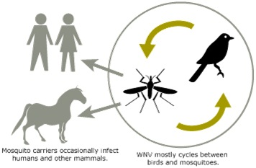
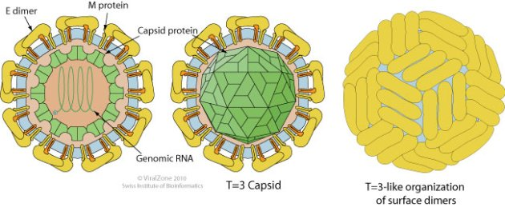
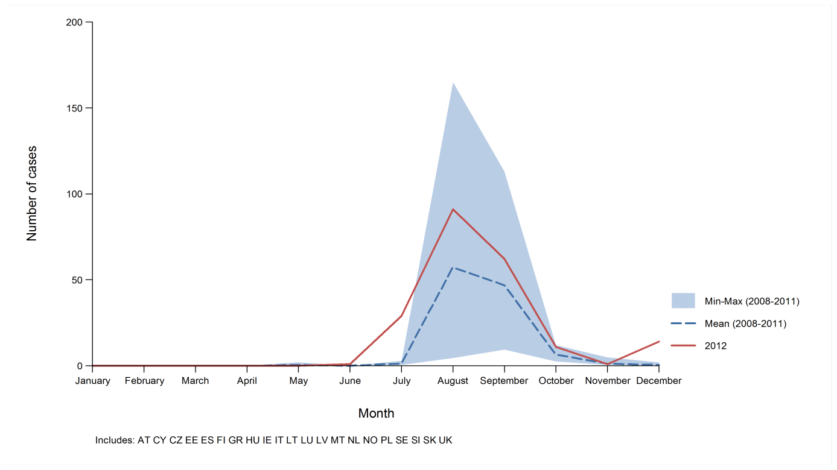
West Nile Virus (Orthoflavivirus nilense)
Virus, vectors, infection transmission cycle, clinical picture
.
West Nile virus, Flavivirus; Enveloped,
40 - 60 nm diameter, +ssRNA, 11-12kb
    Mosquito vectors:
    Culex pipiens
    Culex molestus
    Culex quinquefasciatus
Potential vectors and hosts: >60 mosquito species and over 300 bird species
Incubation Period: 2 to 14 days.
Clinical Signs (humans)
West Nile fever : (relatively mild and flu-like)
West Nile neuroinvasive disease,
80 % WNV infections are asymptomatic.

Slide 19
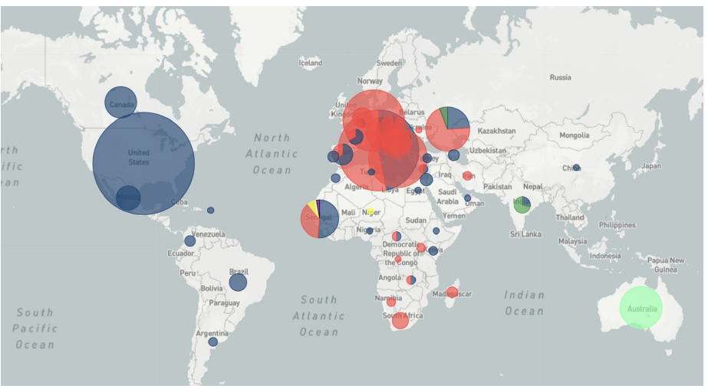
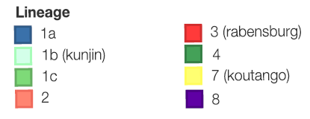
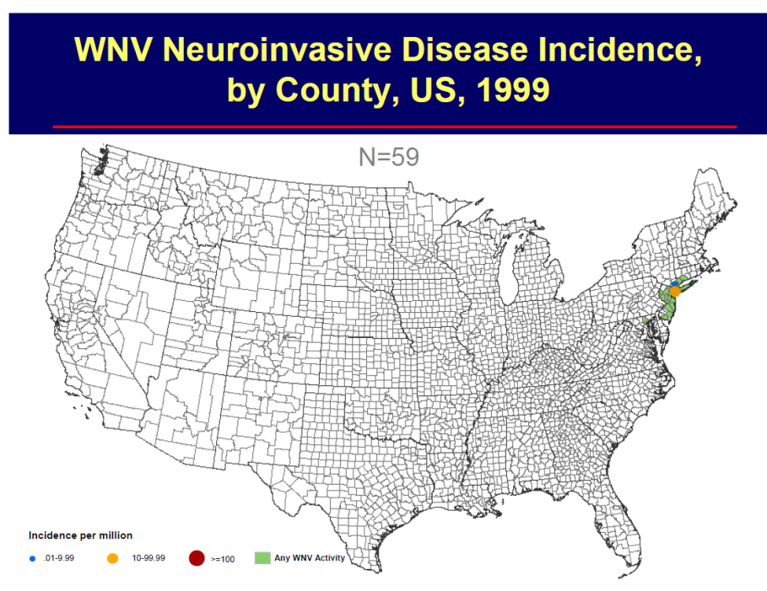
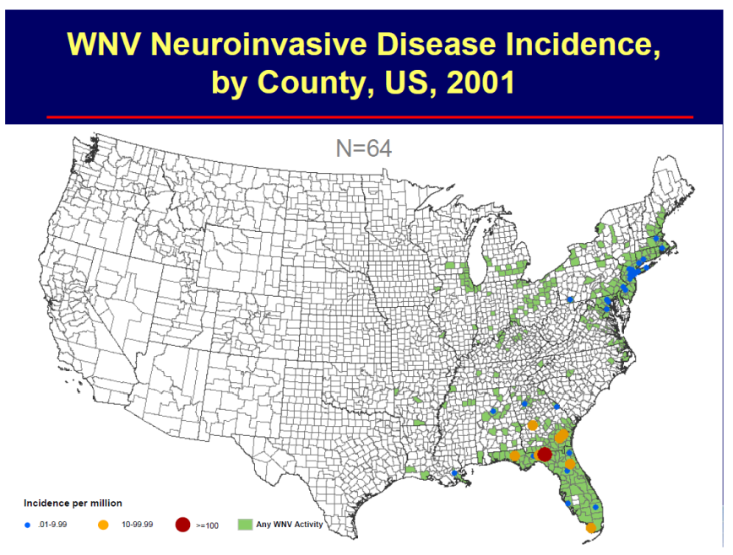
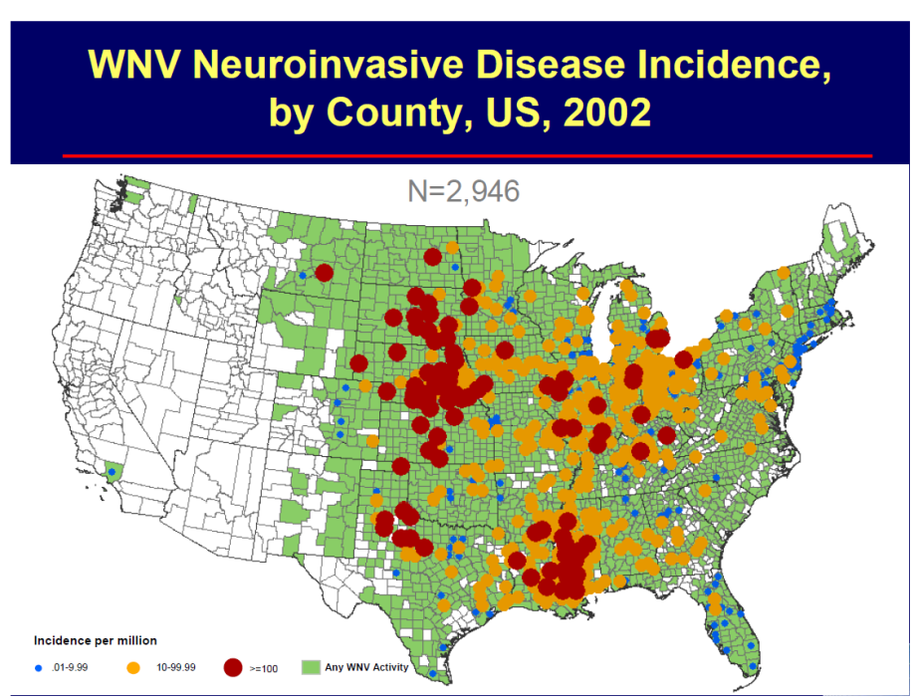
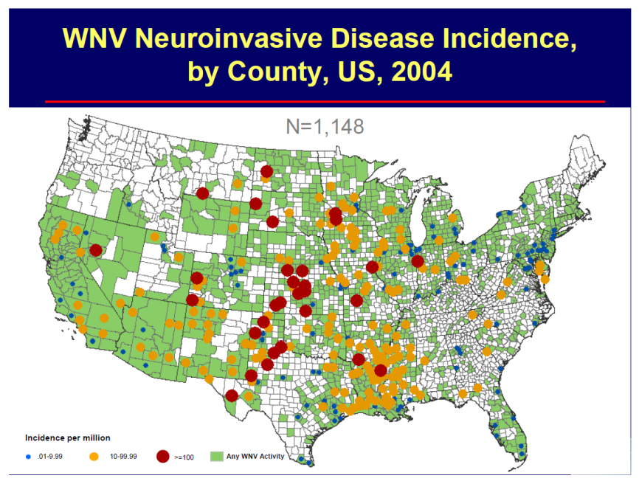
West Nile Virus (Orthoflavivirus nilense)
WNV spread in Europe
1958 – Albania – serosurvey L1a
1962 – France – serosurvey
1996 – Bucharest - Romania (393)L1a
1999 – Russia – (480)
1999 – USA
2004 - Hungary - L2
Tobias Koch R, et al.Genomic epidemiology of West Nile virus in Europe, One Health 2024.
L1a
L1a + L2
ECDC: Annual epidemiological reports WNV.

Slide 20
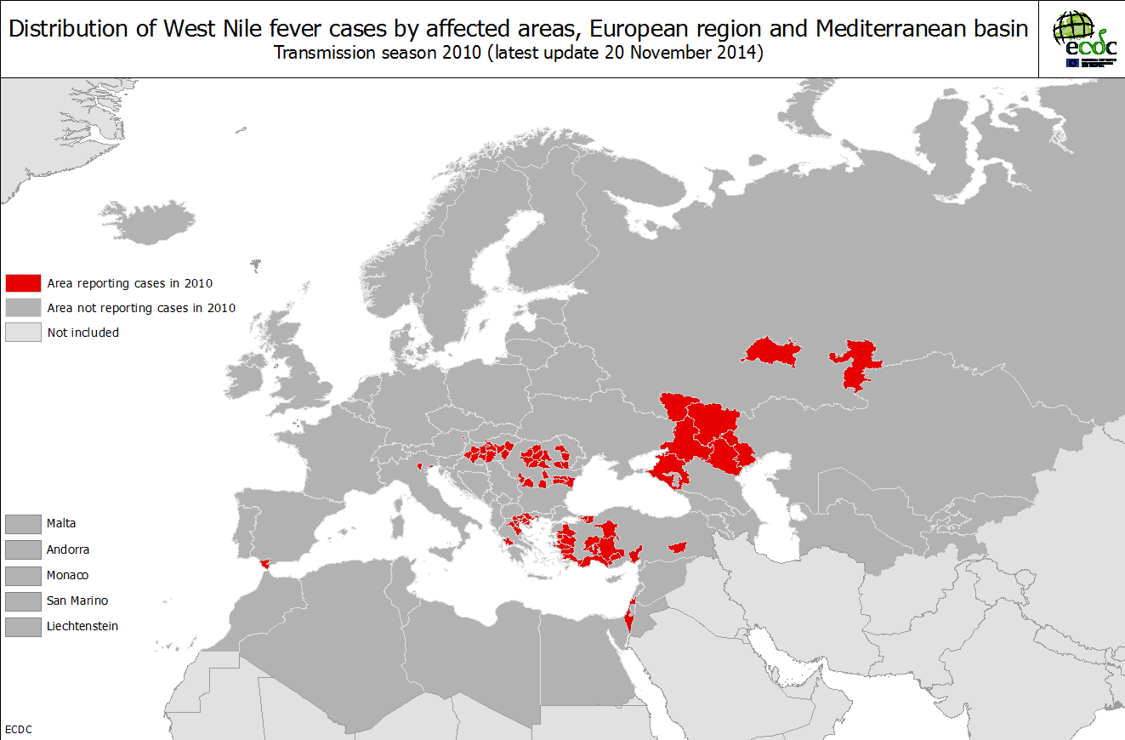
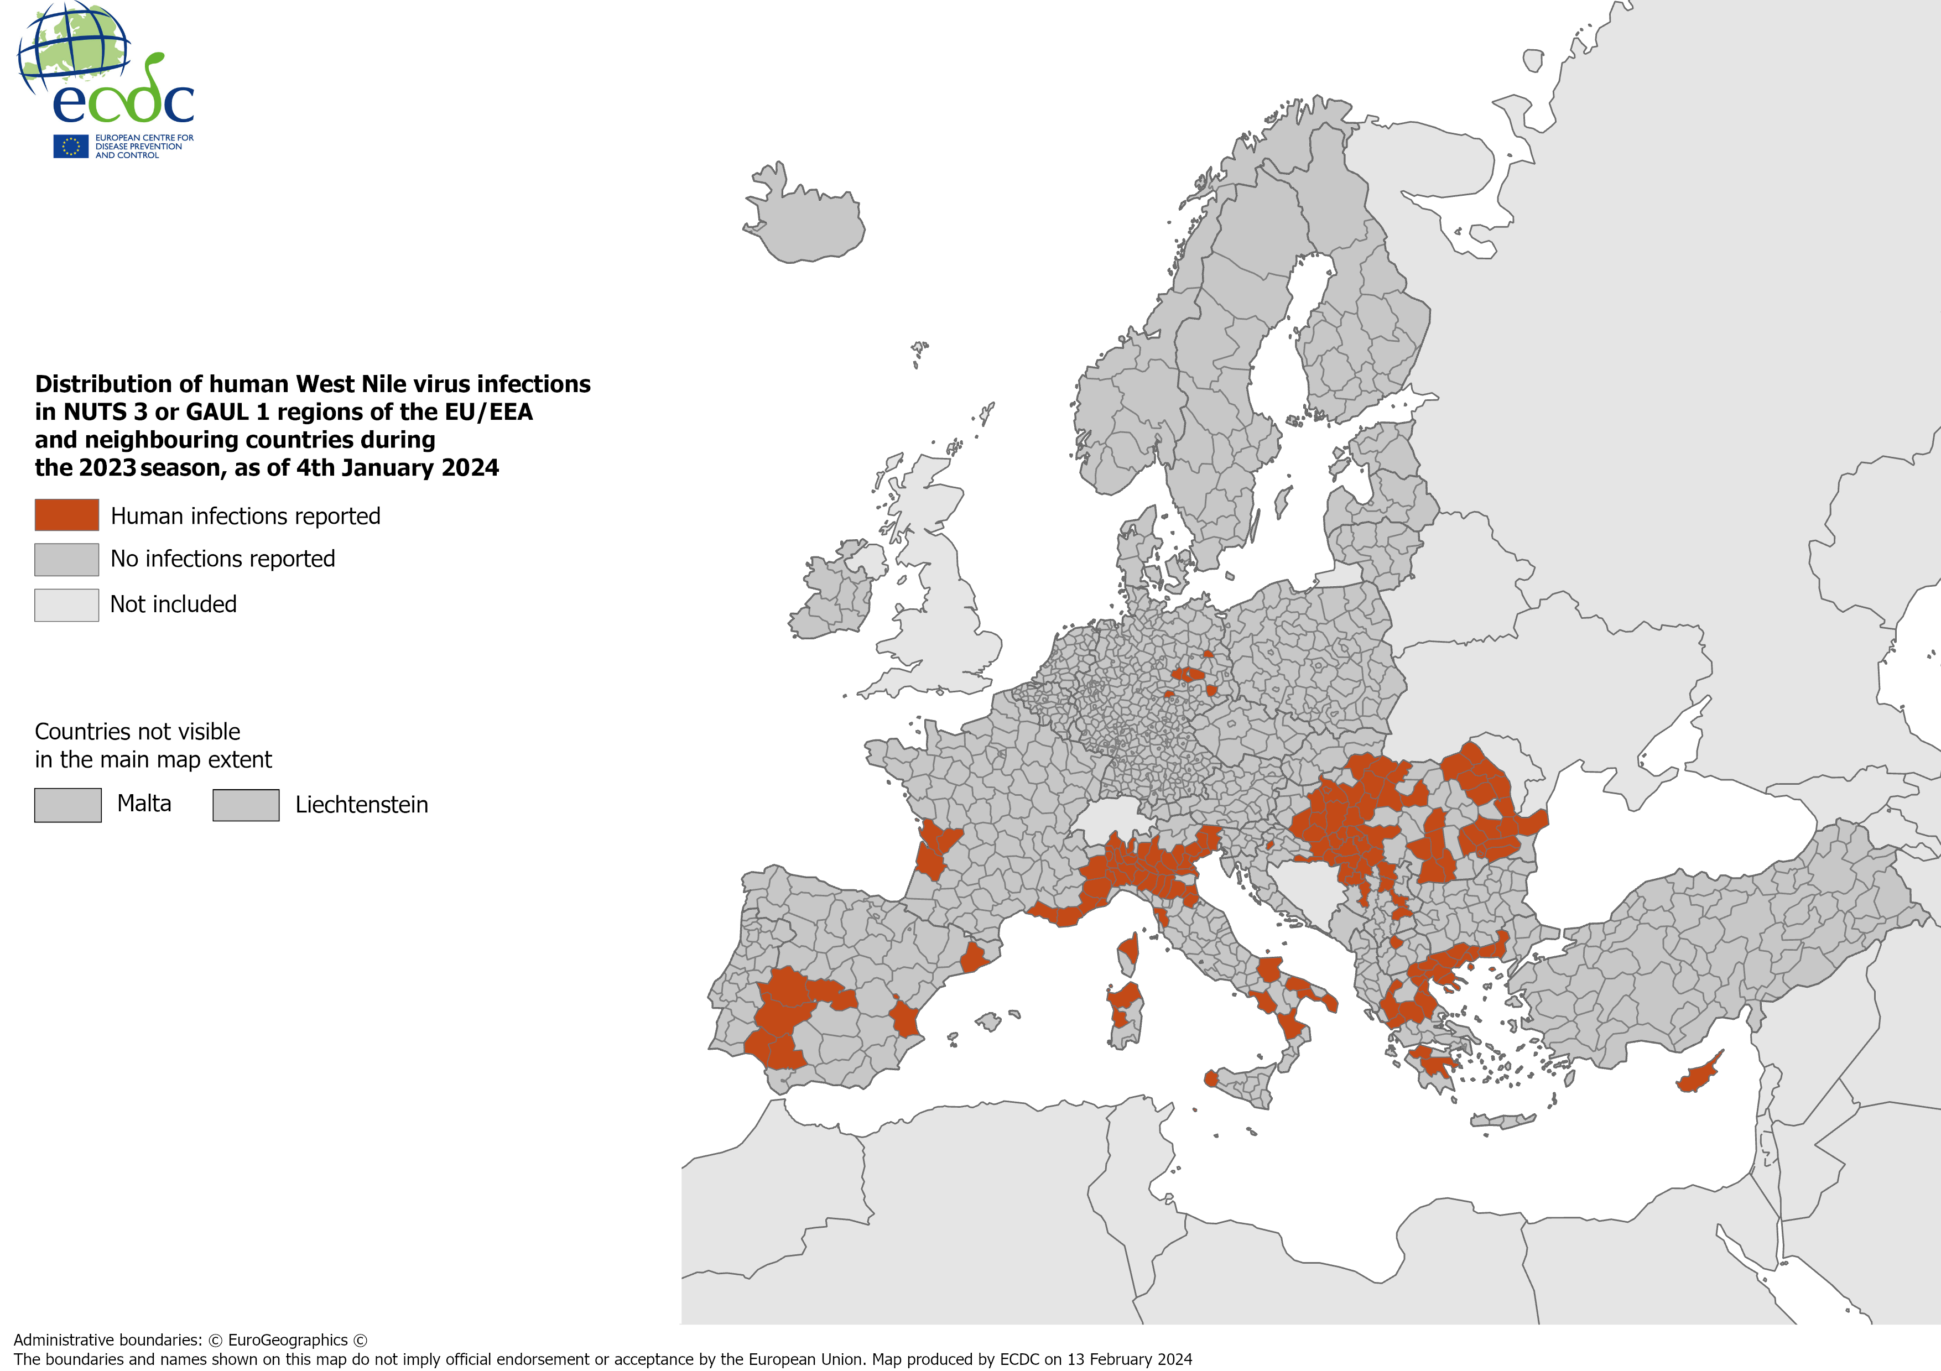
WNV spread in Europe 2010 - 2023
2010
NUTS3/GAUL(1)=49
Countries = 5
2023
NUTS3/GAUL(1)= 148
Countries = 16

Slide 21
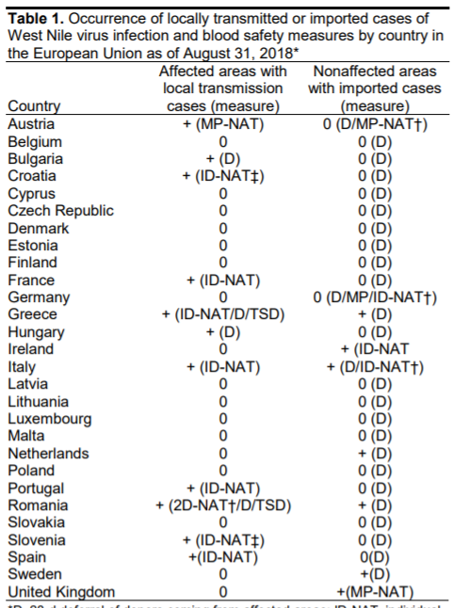
WNV is transmissible via MPHO
COMMISSION DIRECTIVE 2014/110/EU Donor deferral 28 days after leaving a risk area of locally acquired West Nile Virus unless an individual Nucleic Acid Test (NAT) is negative’

Slide 22
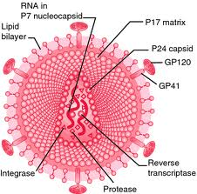
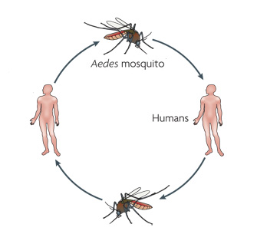
Dengue Virus (Orthoflavivirus denguei)
Virus, vectors, infection transmission cycle, clinical picture
Family: Flaviviridae;
Genus: Orthoflavivirus
Serotypes and genotypes:
  DENV1(5), DENV2(6),
  DENV3(5),DENV4(4)
Enveloped, ~50 nm in diameter
RNA, Linear, +ss RNA, ~10.7 kb
Incubation 5–7 days (range 3–10 days)
Asymptomatic cases 40%–80%
Symptomatic
Mild febrile illness
Dengue Fever
Dengue Shock Syndrome
Massive haemorrhage, organ failure and Neurological disease
Mosquito vectors:
Aedes aegypti
Aedes albopictus
Aedes polynesiensis

Slide 23
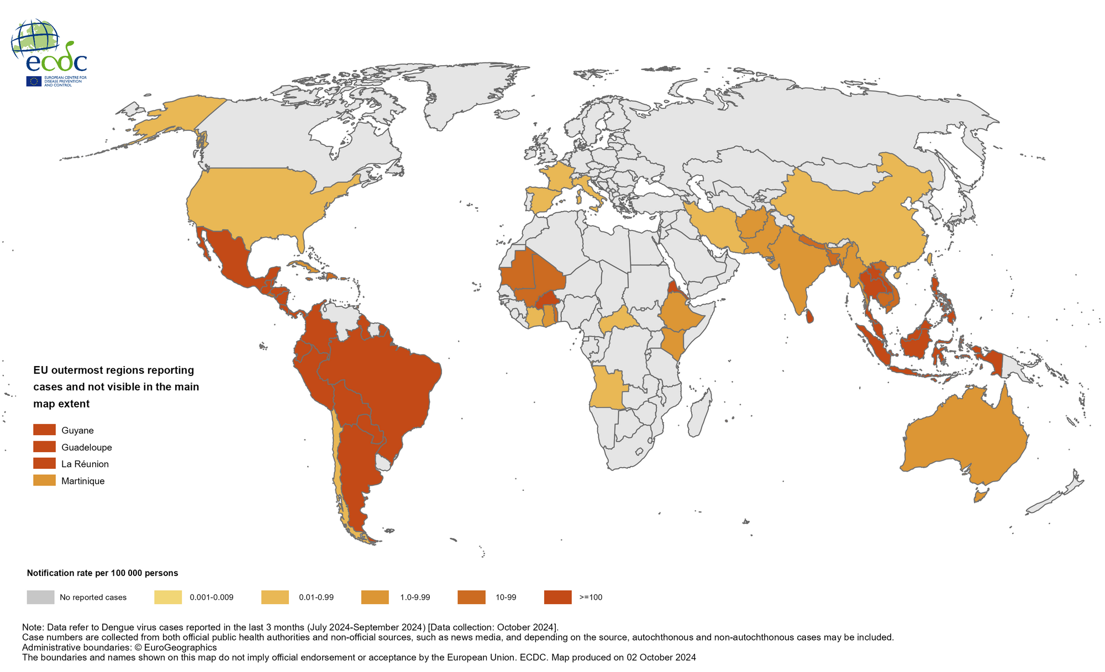
Dengue Virus (Orthoflavivirus denguei)
Three-month DENV disease case notification rate per 100 000 population,
July-September 2024
Dengue cases and rates by year, EU/EEA, 2018–2022
2024 - > 13 million dengue cases and > 8500 dengue-related deaths
ECDC: Annual epidemiological reports DENV.

Slide 24
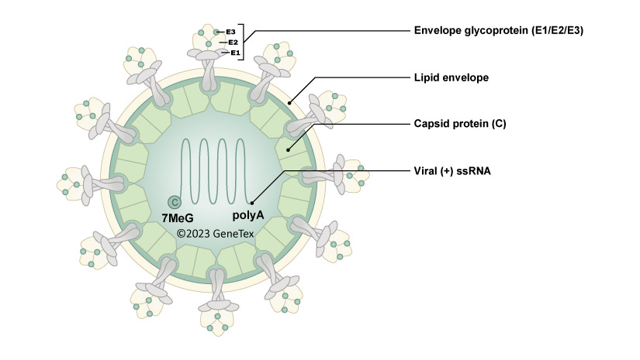
Chikungunya virus (Alphavirus chikungunya)
Virus, vectors, infection transmission cycle, clinical picture
Incubation is 3 to 12 days, without a prodrome
Asymptomatic cases
Symptomatic
headache, myalgia, polyarthralgia > , pruritic, maculopapular concurrent with leukopenia.
Mosquito vectors:
Aedes aegypti
Aedes albopictus
Other species
Family: Togaviridae; Genus: Alphavirus (29)
Genotypes:
Asian and East Central South African (ECSA)
Enveloped, ~50 nm in diameter
RNA - linear, +ss, 11.8 kb in length

Slide 25
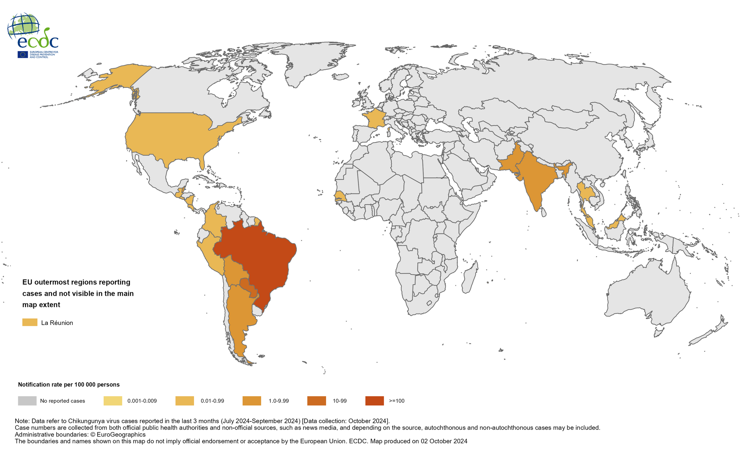
Chikungunya virus (Alphavirus chikungunya)
In 2024 (30 September)~ 460 000 CHIKVD cases and 170 CHIKVD-associated deaths worldwide.
A total of 23 countries reported CHIKVD cases from the Americas (15), Asia (6), Africa (1), and Europe (1).

Slide 26
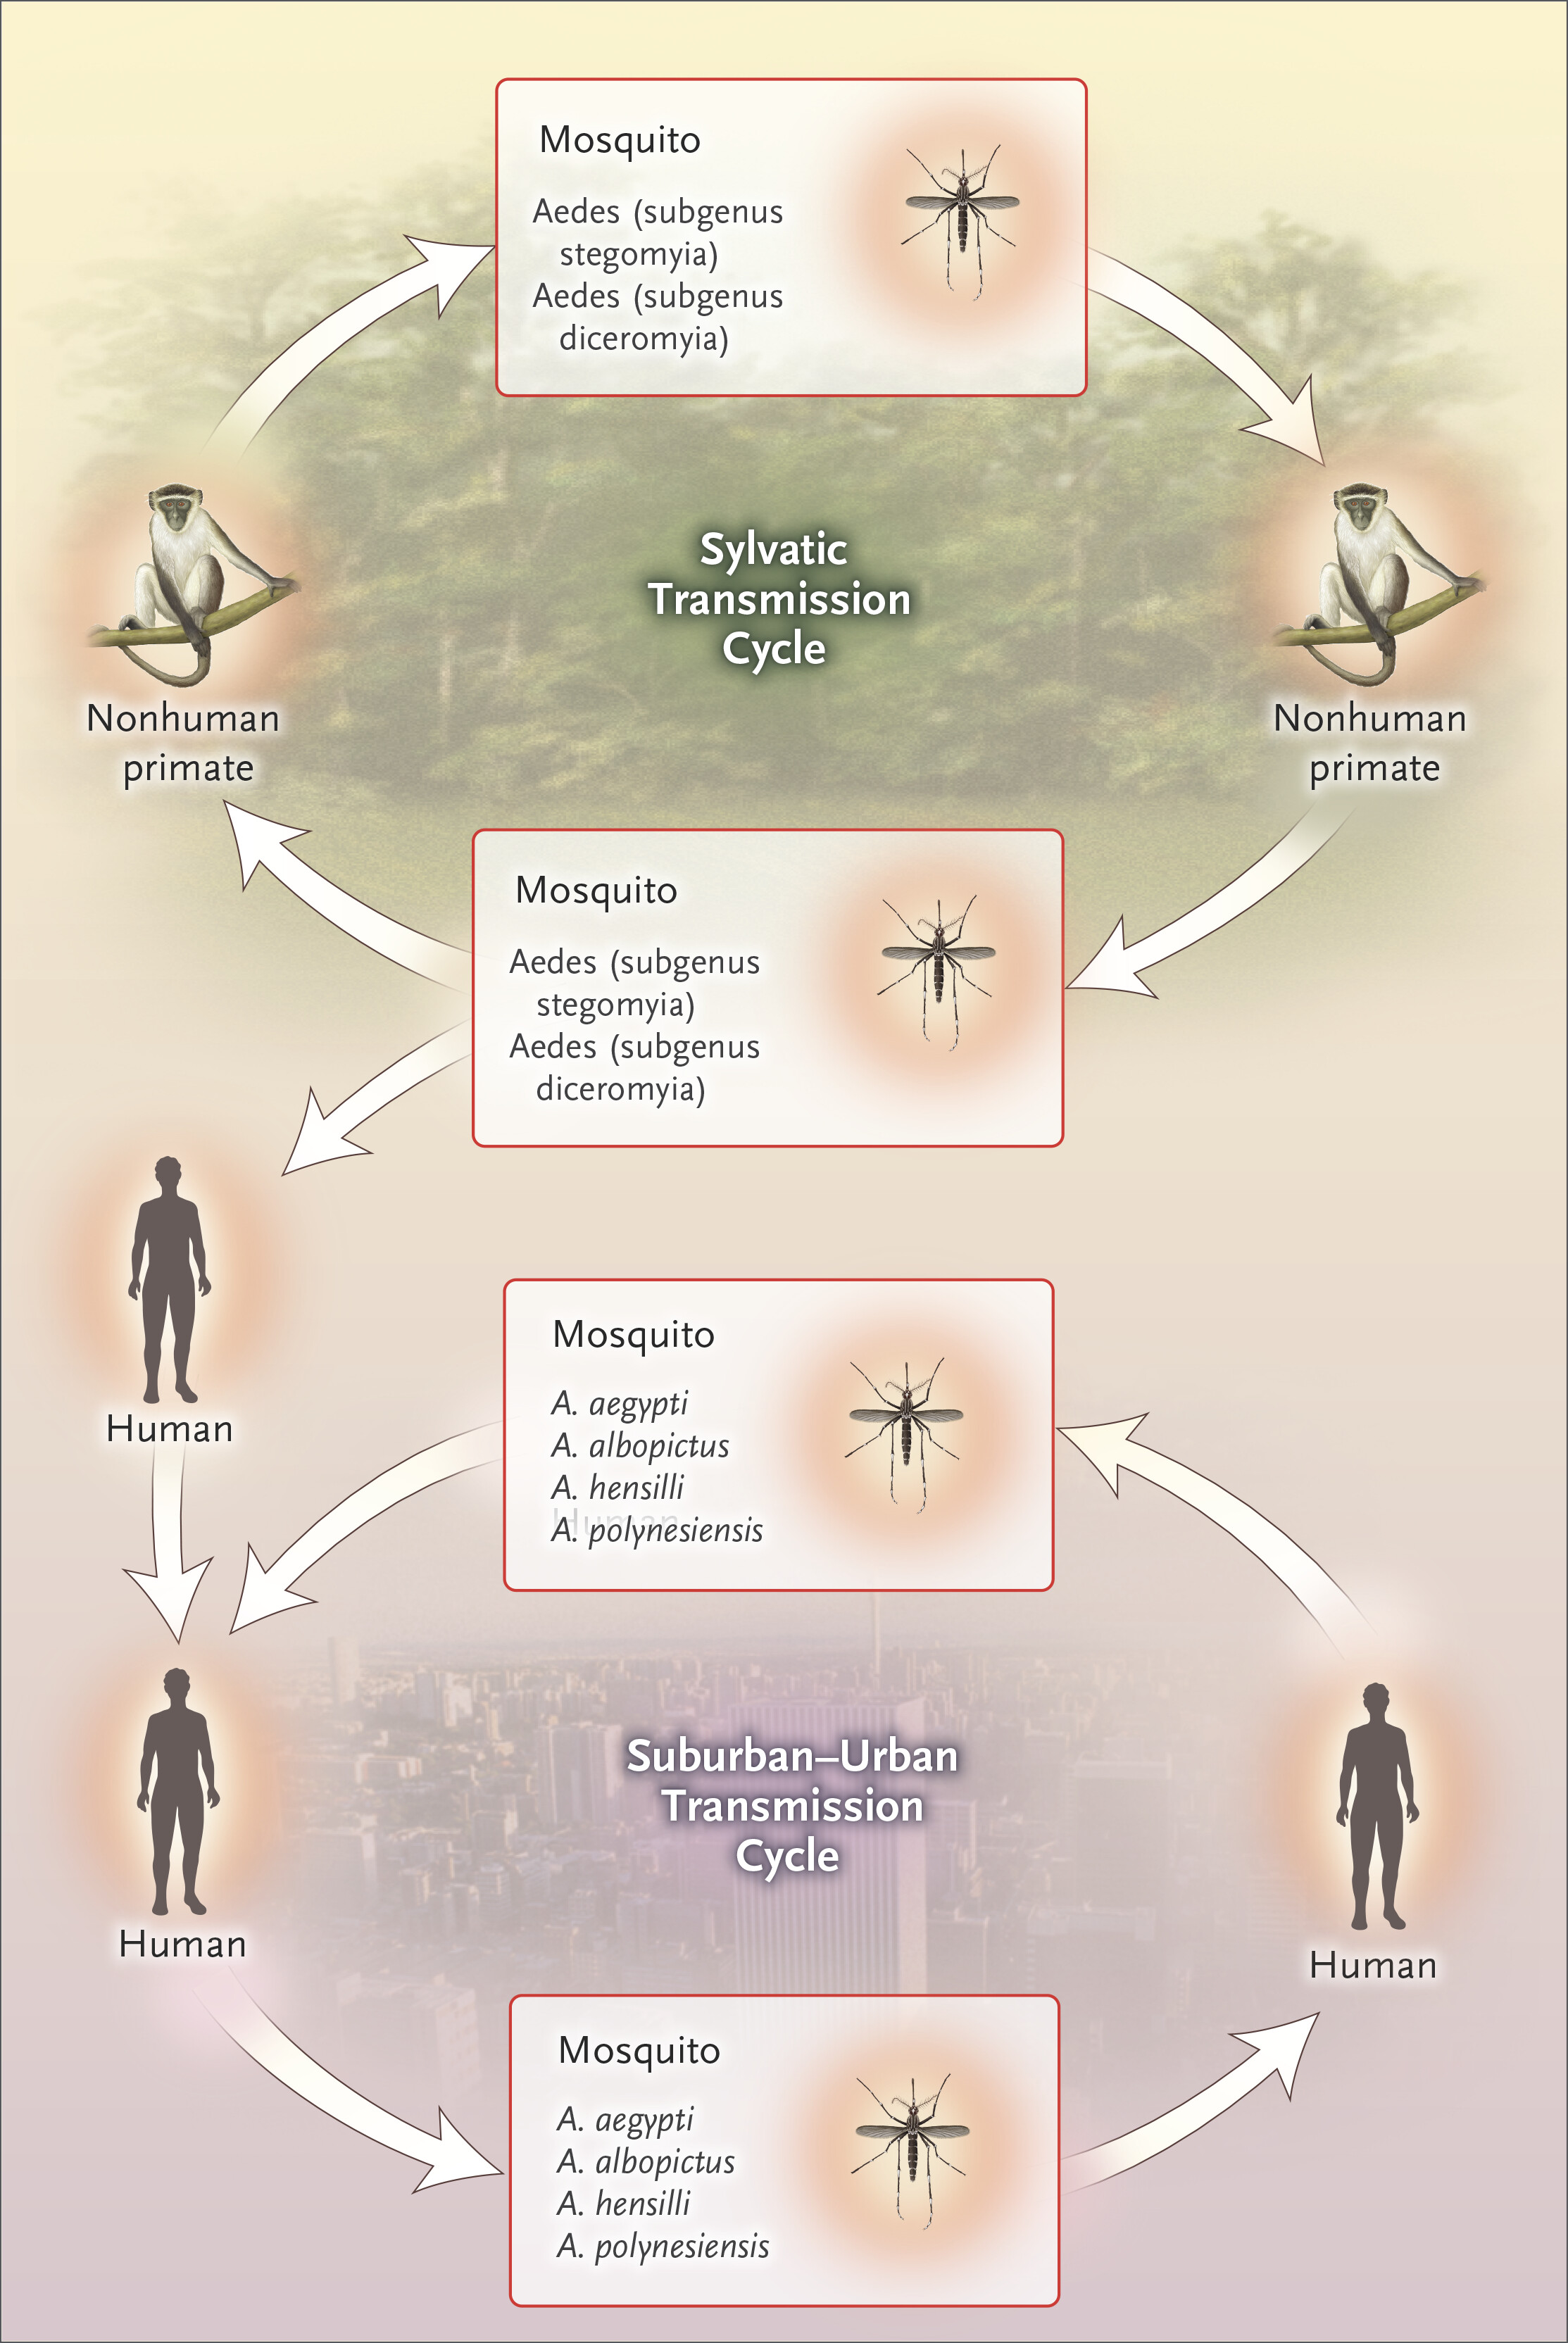
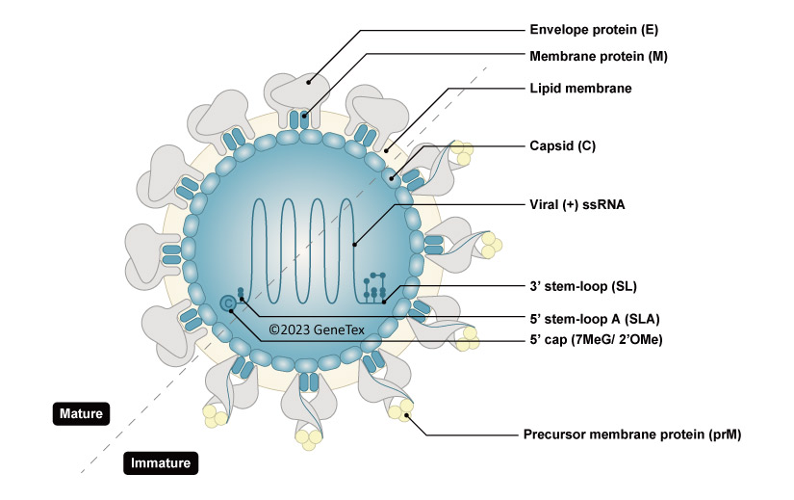
ZIKA virus (Orthoflavivirus zikaense)
3 to 14 days post-exposure
80% - asymptomatic
Common clinical symptoms: maculopapular rash, fever, fatigue, arthralgia, myalgia, headache and conjunctivitis
Neurological complications:
Guillain–Barré syndrome, meningoencephalitis,
Congenital Zika syndrome: microcephaly, abnormal brain development, limb contractures, eye abnormalities, brain calcifications and other neurological complications
Family: Flaviviridae;
Genus: Orthoflavivirus
Main lineages:
Asian, East African and West African
40-60 nm in diameter
11kb in lenght

Slide 27
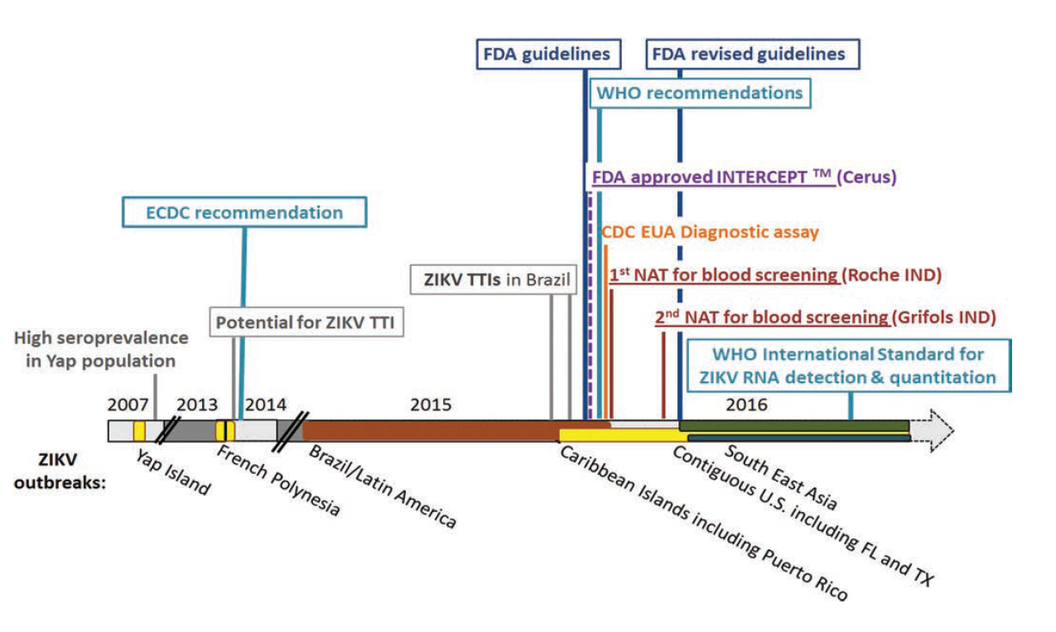
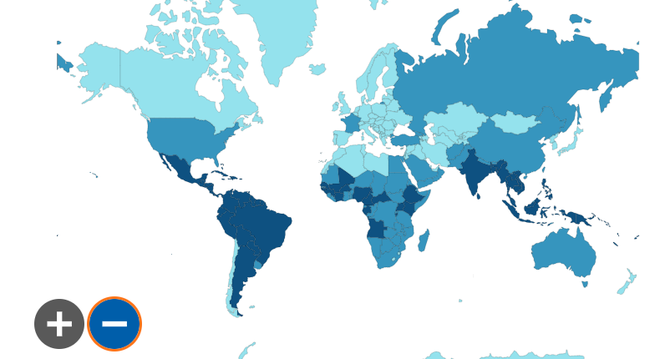
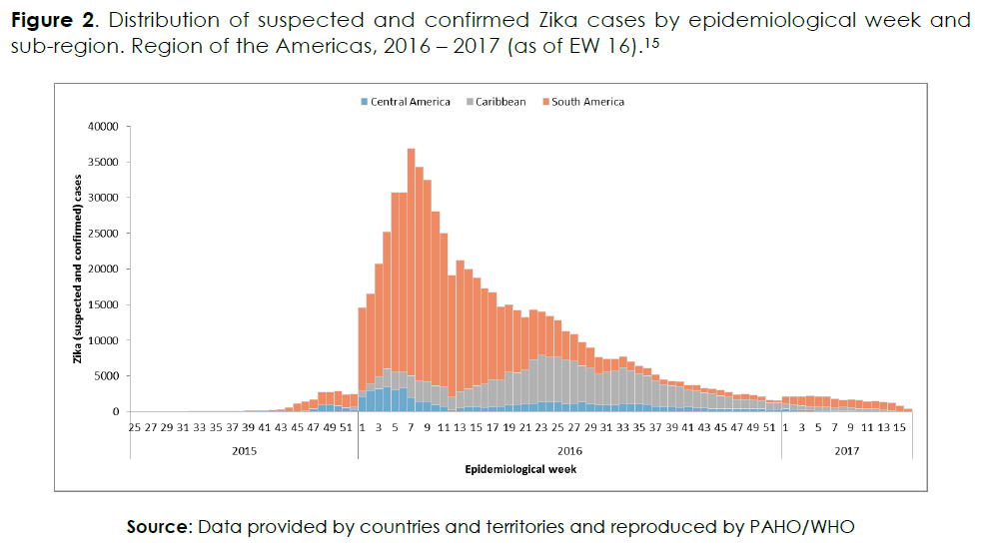
ZIKA virus (Orthoflavivirus zikaense)
Zika virus infections worldwide
ECDC Guide
Current or past transmission
Transmission - , vector +
Transmission -, vector - ,
440,000-1,300,300 cases of ZIKV infection occurred in 2015 in Brazil
3 probable TT ZIKV cases

Slide 28
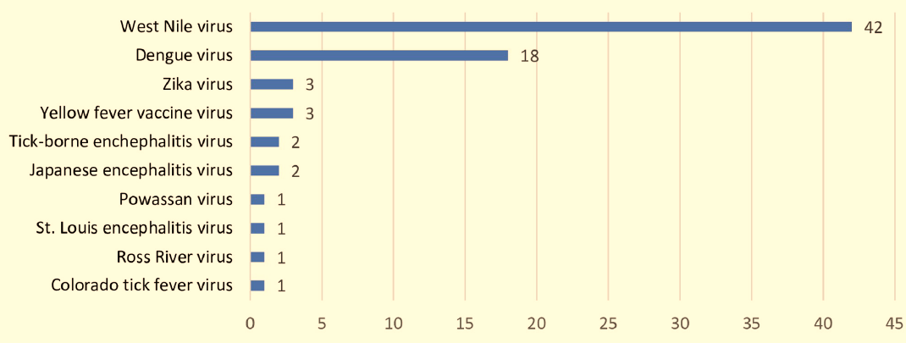
Reported cases of TT arboviruses
As of 2022
Total: 74
Giménez-Richarte Á, Ortiz de Salazar MI, Giménez-Richarte MP, Collado M, Fernández PL, et al. (2022) Transfusion-transmitted arboviruses: Update and systematic review. PLOS Neglected Tropical Diseases 16(10): e0010843. https://doi.org/10.1371/journal.pntd.0010843

Slide 29
Prevalence of CHIKV, DENV and ZIKV
Blood donors, systematic review and meta analysis
Included: CHIKV -18 records, DENV - 71 records and ZIKV- 27 records
 | CHIKV | DENV | ZIKV
Highest prevalence of RNA-positive donors | 1.9% Puerto Rico (2019) | 5.5% Saudi Arabia (2015-16) | 2.8% French Polynesia (2013-14)
 | 1.0% Thailand (2009) | 2.3% Madeira, Portugal (2012-13) | 2.7% Brazil (2015-16)
 | 1.0% French Polynesia (2014-2015) | 0.6% Brazil (2012) | 1.8% Martinique (2016)
Overall seroprevalence IgG | 21.6% | 24.0% | 5.1%
Giménez-Richarte Á, et all. Prevalence of Chikungunya, Dengue and Zika viruses in blood donors: a systematic literature review and meta-analysis. Blood Transfus. 2022 Jul;20(4):267-280. doi: 10.2450/2021.0106-21.

Slide 30
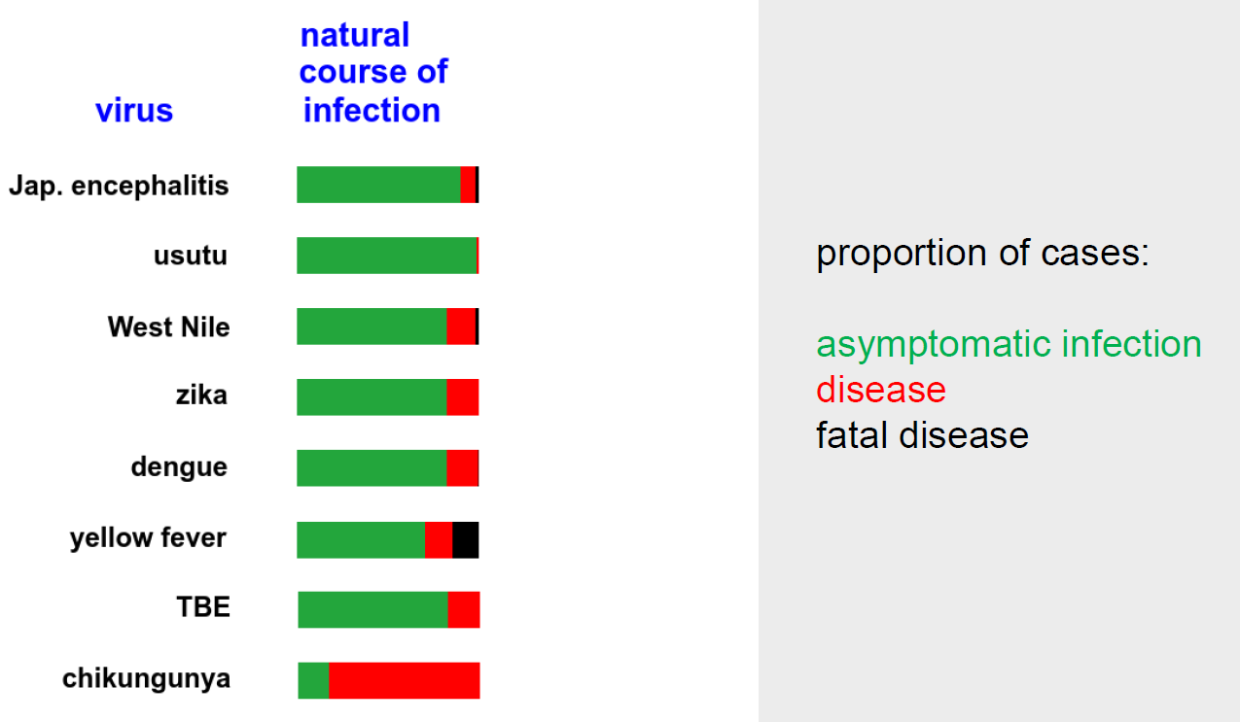
The natural course of some ARBO infections
Adapted from Zaaijer H. Presentation at the IPFA/PEI meeting Bologna, 2023.

Slide 31
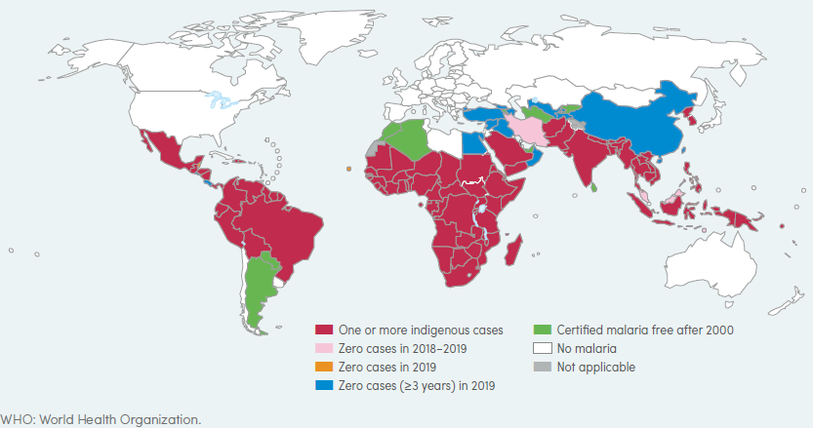
Malaria
Distribution of countries with Indigenous malaria
Total number of malaria cases in EU/EEA
Globally, there were an estimated 229 million malaria
cases in 2019 in 87 malaria-endemic countries
In the USA, the risk of TTM is currently estimated at less than 0.1 per million red blood cell (RBC) transfusions, or about 1 case every 2 years
Rare cases of transplantation transmitted malaria (organs and BMT) Deferral policy implemented in non-malarial countries – revision is ongoing

Slide 32
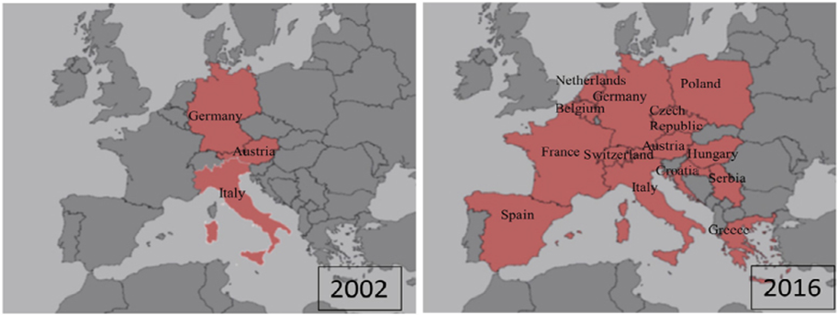
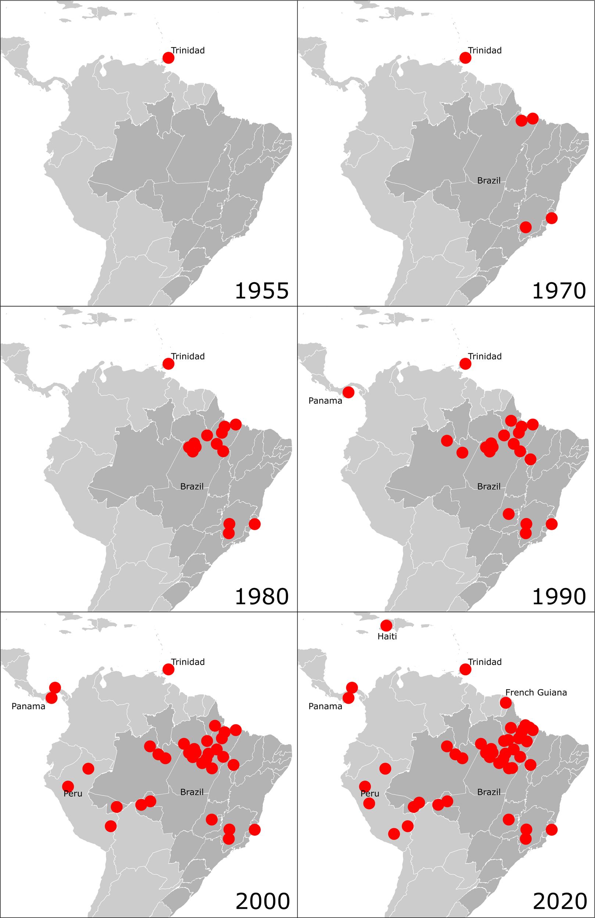
Potential threats to MPHO in Europe
Usutu virus (USUV)
Tick-borne protozoa
Babesia microti
Tick-borne viruses
Omsk hemorrhagic fever virus (OHFV),
Kyasanur Forest disease virus (KFDV),
Alkhurma haemorrhagic fever virus (AHFV)
Oropouche virus (OROV)

Slide 33
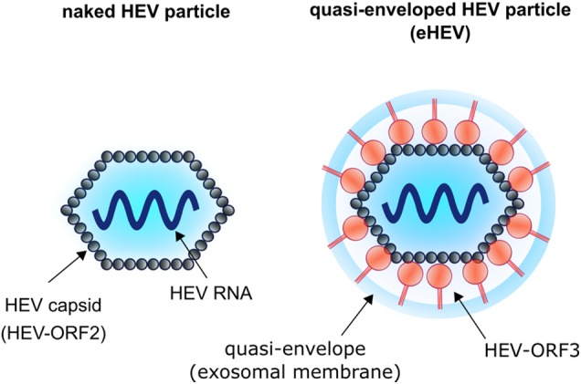
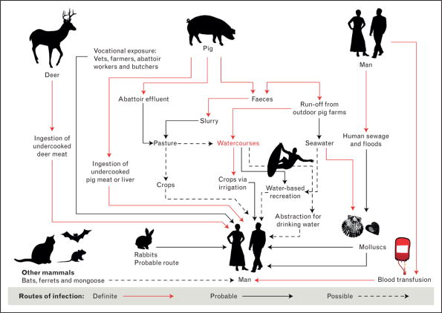
Hepatitis e virus
Virus, transmission, clinical manifestations
Zoonotic transmission
Transmission:
Fecal Oral
Zoonotic
Person to person
Vertical
Fam: Picornaviridae, Subfam: Heptrevirinae; Genus: Hepatovirus
Nonenveloped, icosahedral spherical particles,
27–34 nm diameter; RNA, linear, +ss, 7.2 kb in length
Quasi-enveloped HEV particles
Orthohepevirus A (8 genotypes) HEV-1, -2, -3 and -4
Orthohepevirus C – rats, cross-species infection
Incubation: 2-6 weeks, predominantly asymptomatic, acute hepatitis 5-30%, acute liver failure rare (elderly), fulminant hepatitis - pregnant women and patients with pre-existing liver disease, immunocompromised patients resulting in chronic infection (HEV3 and HEV4)

Slide 34
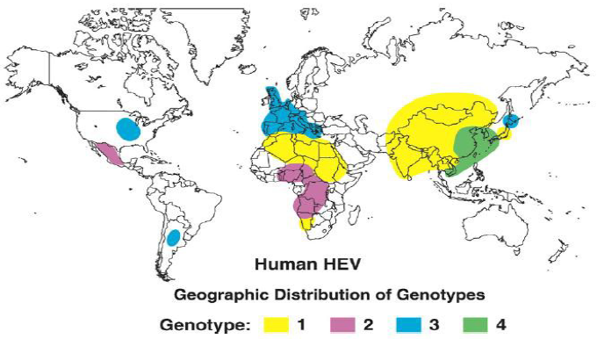
Hepatitis e virus
Continent | HEV seroprevalence IgG
Africa | 21.76%
Asia | 15.80%
Eurrope | 9.31%
North America | 8.05%
Southe America | 7.28%
Oceania | 5.99%
High frequency of asymptomatic infections;
Long viraemic phase (4-6 weeks with titers up to 10⁵ IU/ml);
High HEV RNA prevalence in blood donors;
Ineffective viral inactivation or reduction;
Confirmed transmission by blood components, bone marrow and organs in immunosuppressed patients;
Higher mortality and morbidity in immunosuppressed patients

Slide 35
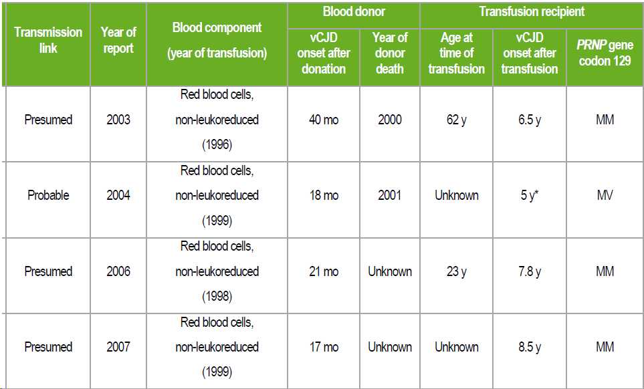
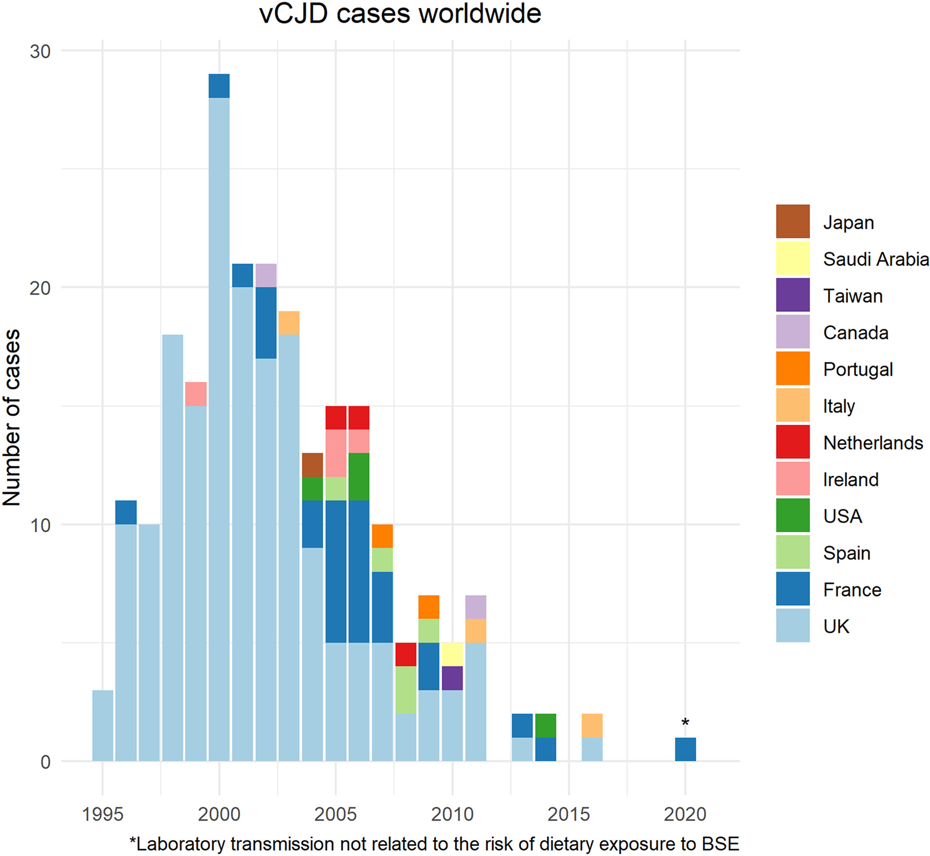
Variant Creutzfeldt-Jakob Disease
N = 232
FVIII - One possible case
No cases of transmission via cells, tissues and organs
Prevention:
Primary transmission –
Control measures implemented in a food safety system
Secondary transmission of vCJD by transfusion (transplantation)
Permanent deferral of donors at risk of dietary exposure to BSE or vCJD by transfusion receipt
Reducing the potential infectivity in donated blood by leukocyte removal or prion removal from plasma and plasma-derived medicinal products (PDMPs).
Preventive discontinuation of the use of domestic plasma for fractionation (UK 1996).

Slide 36
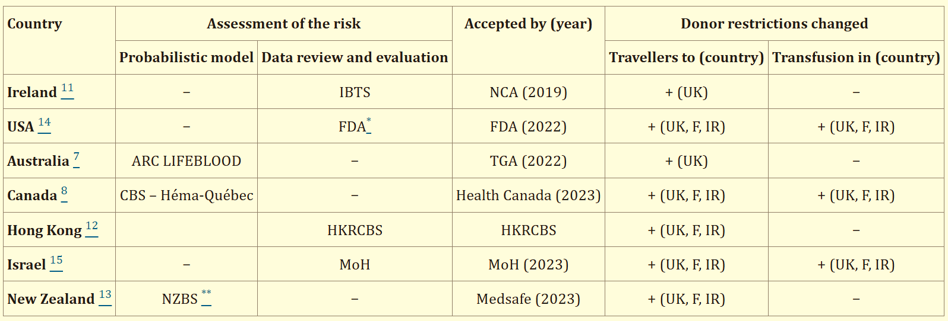
Removal of vCJD-associated restrictions
In 2021, the UK lifted the ban on using UK-sourced plasma to produce immunoglobulins, enacted in 1996.
Domanović D, et al. Assessing the risk of transfusion-transmitted variant Creutzfeldt-Jakob disease: a European perspective. Blood Transfus. 2024 Sep;22(5):415-419. doi: 10.2450/BloodTransfus.778. Epub 2024 May 16. PMID: 38814884; PMCID: PMC11390612.

Slide 37
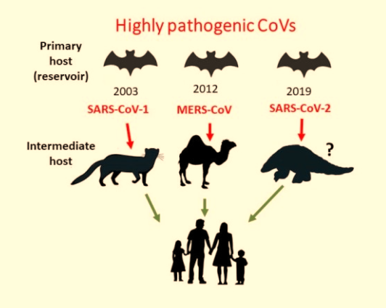
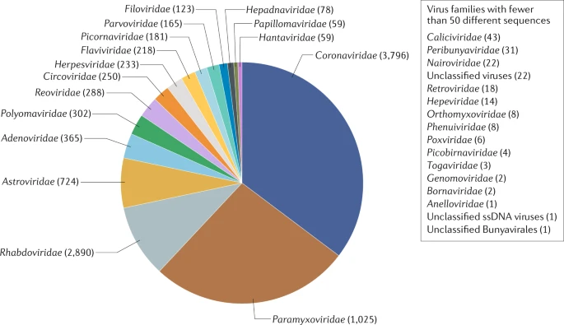
Highly pathogenic human corona viruses
Virus spillovers
Ongoing threat of bat-borne viral emergence
Shors, Teri. “Coronavirus.” AccessScience, McGraw-Hill Education, May 2020
https://www.nature.com/articles/s41579-020-0394-z

Slide 38
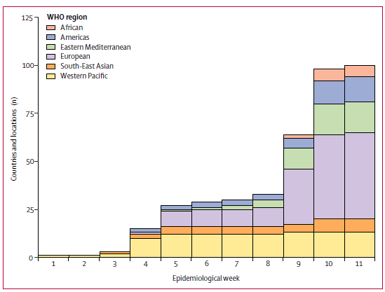
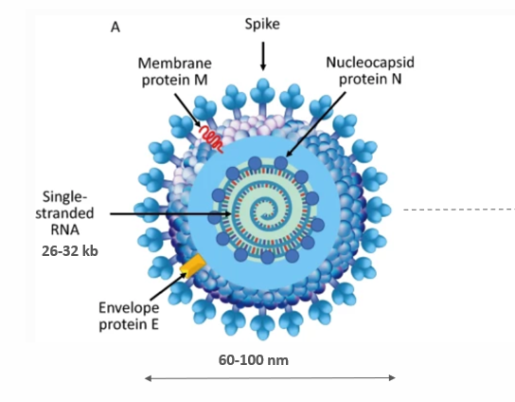
Early spread of COVID-19
Confirmed cases of COVID-19, by WHO region and epidemiological week, from Dec 31, 2019, to March 10, 2020
Compared with the SARS-CoV and MERS-CoV, SARS-CoV-2 spread more rapidly in the early weeks of the outbreak.
Almost two-thirds of the first cases in affected countries were in people reported to have recently travelled from affected countries (China, Iran, and Italy).
Dawood FS, et al. Observations of the global epidemiology of COVID-19 from the pre-pandemic period using web-based surveillance: a cross-sectional analysis. Lancet Infect Dis. 2020.

Slide 39
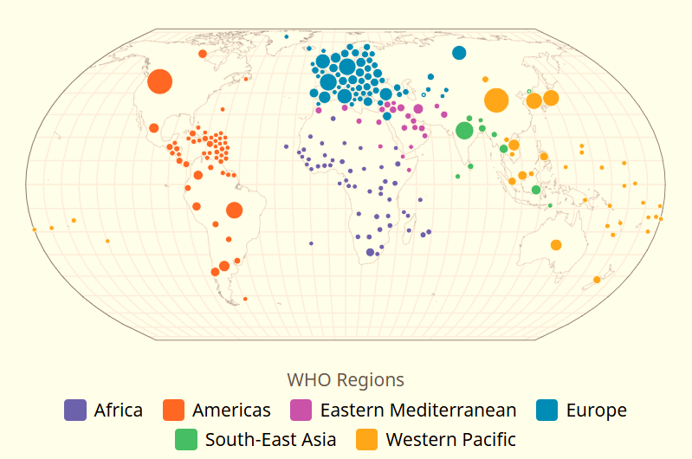
COVID-19 and MPHO safety
As of October 2024
Cases: 776,696,616
Deaths: 7,072,509
Vaccination coverage: 67% primary vaccination
Risks:
Risk of COVID-19 transmission through MPHO is negligible (ECDC). No cases of COVID-19 transmission through blood and blood components, tissues and cells, and PDMPs. One case of transmission lung transplantation
Risk to availability and sustainability of MPHO supply (donor and staff availability)
Risk for patients - recipients of MPHO ( exposure to infection and affected health care capacities)

Slide 40
Summary
Since the last decades, EIDs have been occurring at an increasing rate, many of which have been classified as Public Health Emergencies of International Concern (PHEICs), and some have escalated to pandemics.
Significant insights have been gained into managing EIDs transmissible by MPHOs and preventing related safety threats. We are beginning to understand how to tackle challenges to the MPHO supply posed by the EIDs, which are showing global spread, high contagiousness, and the effects of related public health interventions on the availability of donors, healthcare capacity, and personnel.
As EID drivers intensify, the likelihood of future outbreaks increases, posing new threats to the safety and the availability of MPHO.

