Slide 1
Tissues:
what makes them different?
A/P Marisa R Herson, MD, PhD - Deakin University, School of Medicine, Australia

Slide 2
Tissue donation and the impact of tissue transplantation
Outline of presentation
What makes human tissues different?
What is different - from donation to utilization
What happens less...
and the consequences

Slide 3
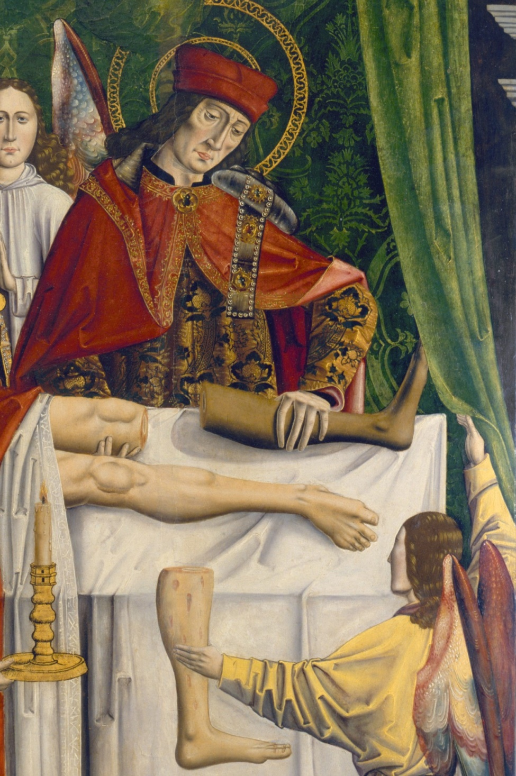
Tissue donation and the impact of tissue transplantation

Slide 4
Tissue Donation and the impact of tissue transplantation
The generosity of the ‘gift’

Slide 5
Tissue donation and the impact of tissue transplantation
Blessing no. 1
Tissues can be donated both by deceased or living donors (FH, birth tissues) = expanded donation opportunities

Slide 6
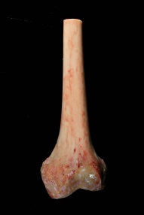
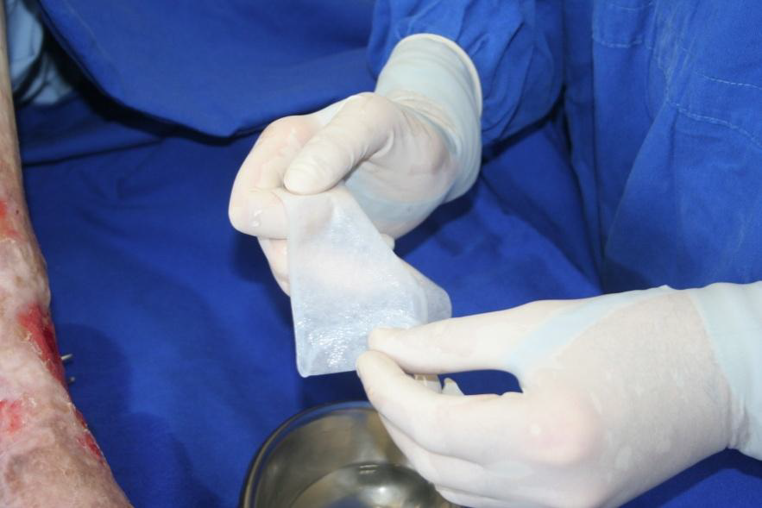
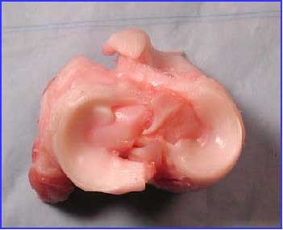
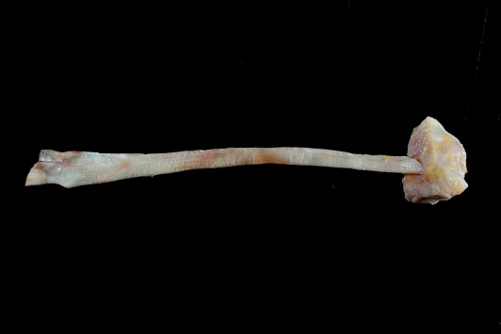
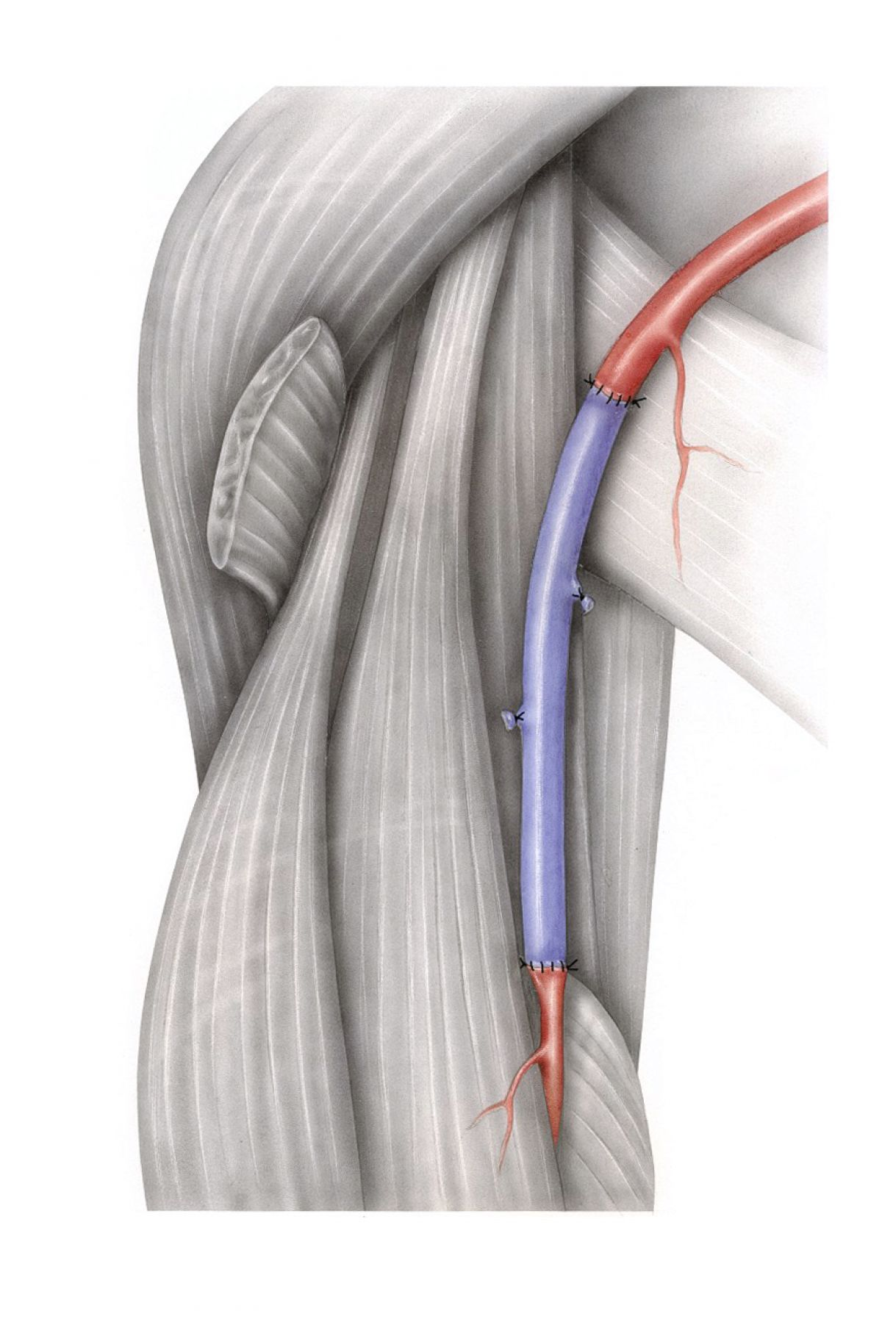
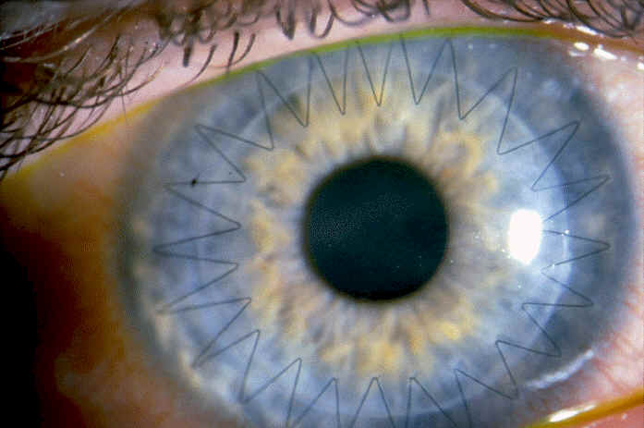
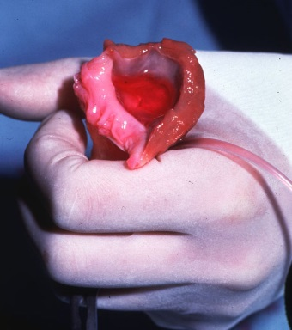
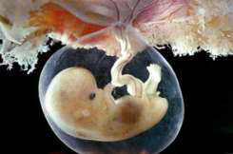
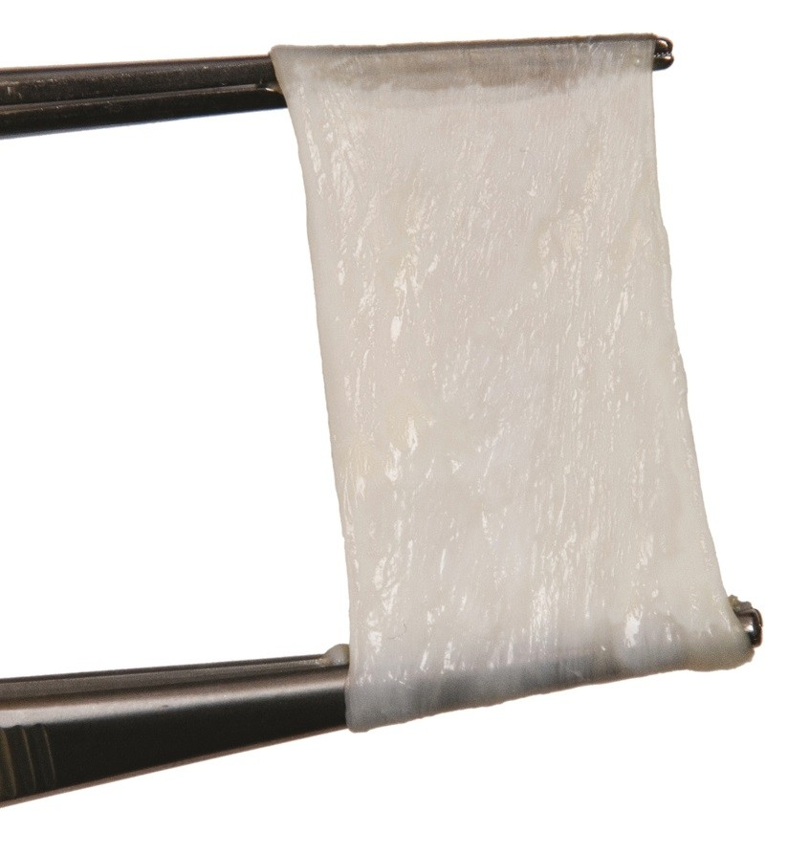
Tissue donation and the impact of tissue transplantation
Blessing no. 2
Tissue donation
Musculoskeletal – bone, tendon, fascia cartilage , menisci
One tissue donor can donate many different tissue types
Cardiovascular – valves, conduits, pericardium
Skin – full, partial thickness
Eye tissue - corneas, sclera
Birth tissue – amnion, chorion, placenta

Slide 7
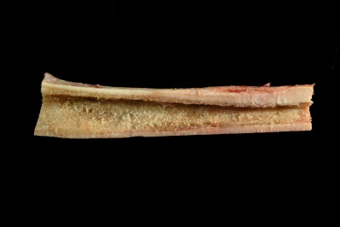
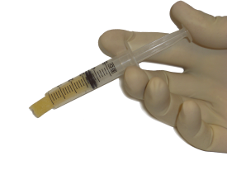
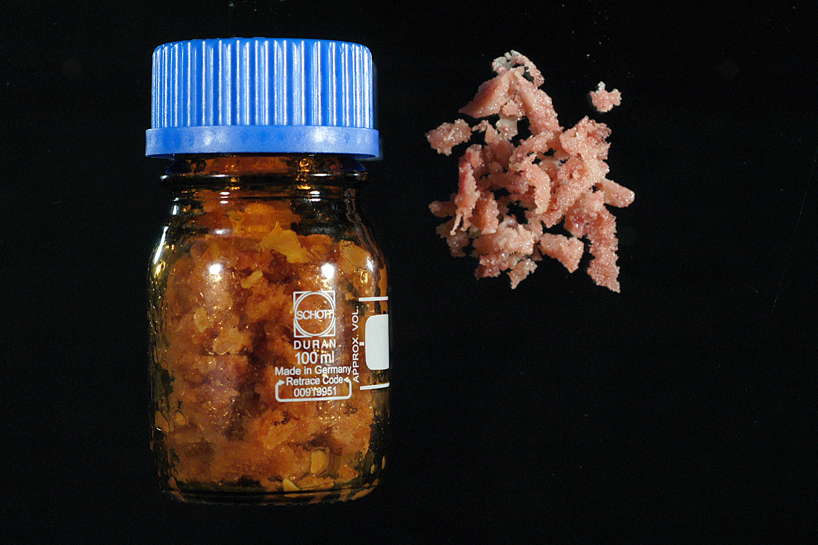
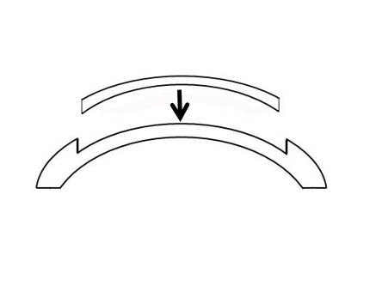
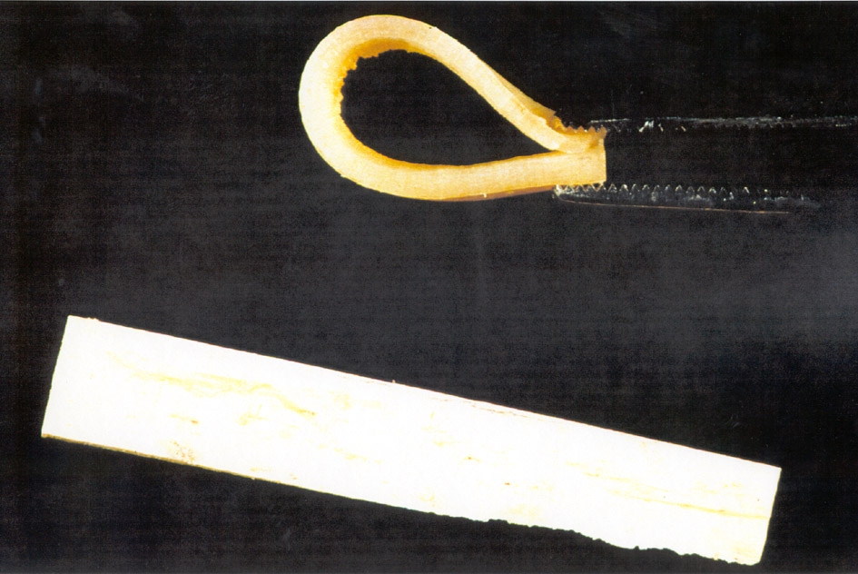
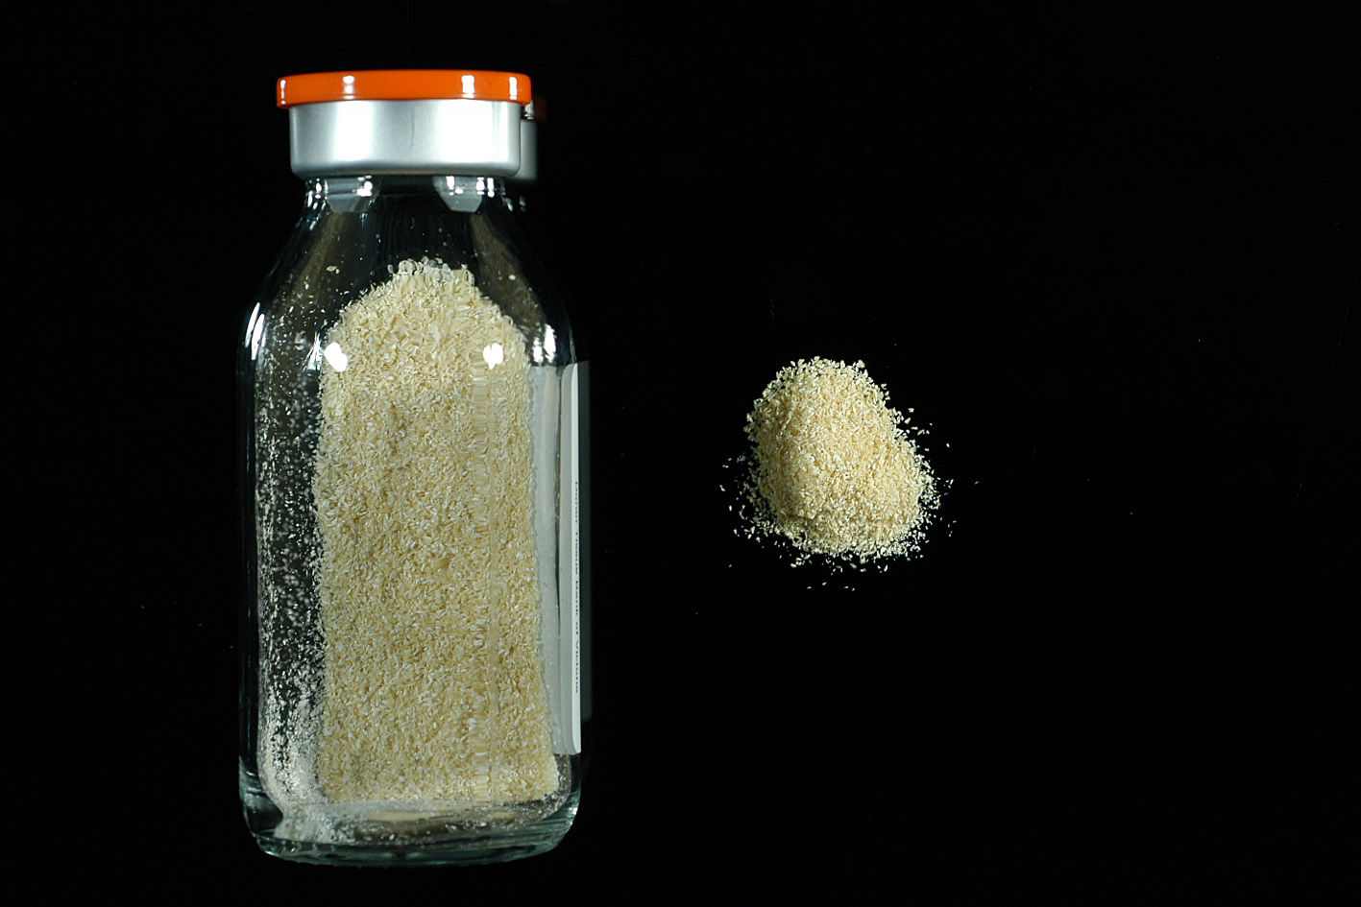
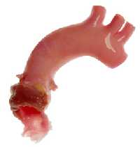
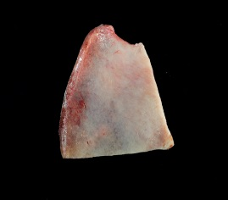
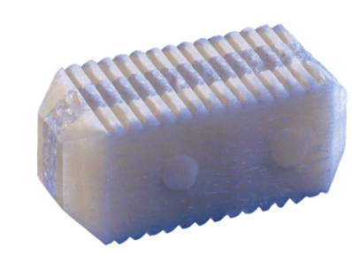
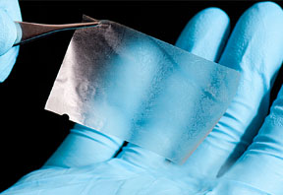
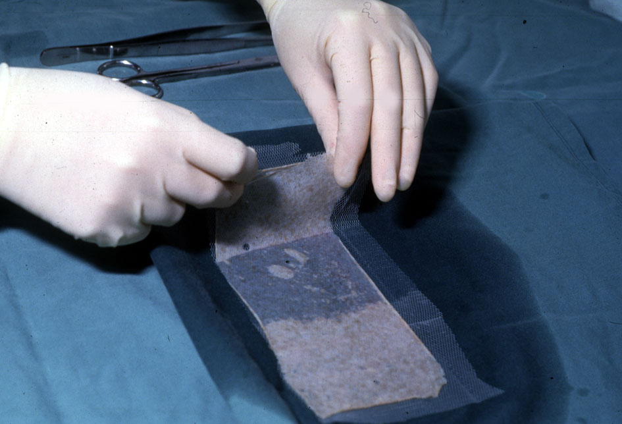
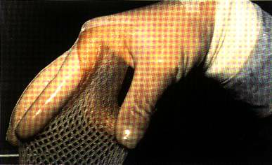
Tissue donation and the impact of tissue transplantation
Blessing no. 3
Each donated tissue type can generate a myriad of grafts through further processing
Donated tissues can become sources of cells and scaffold materials

Slide 8

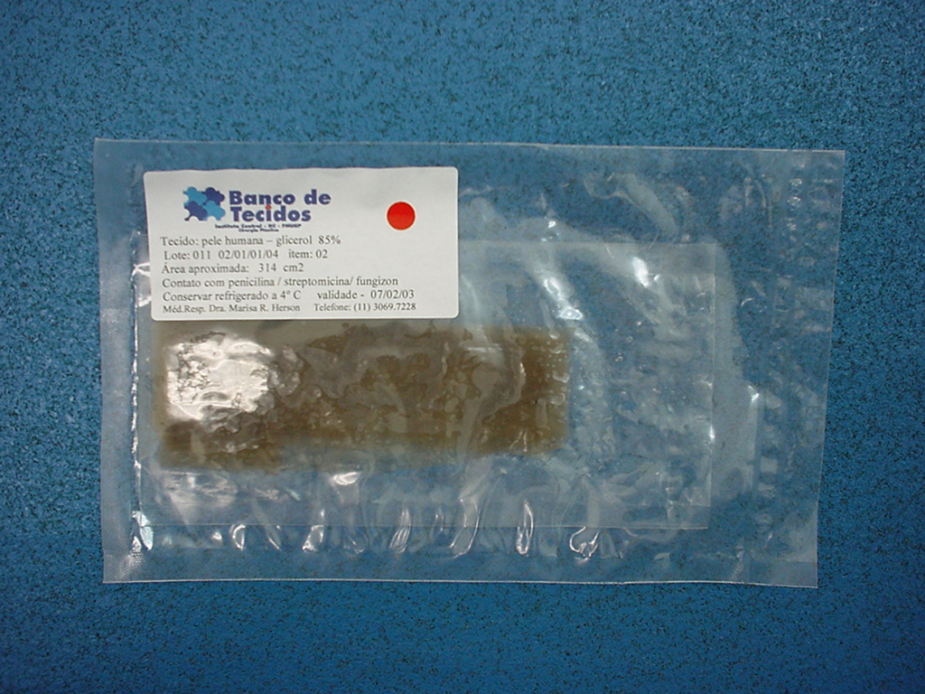
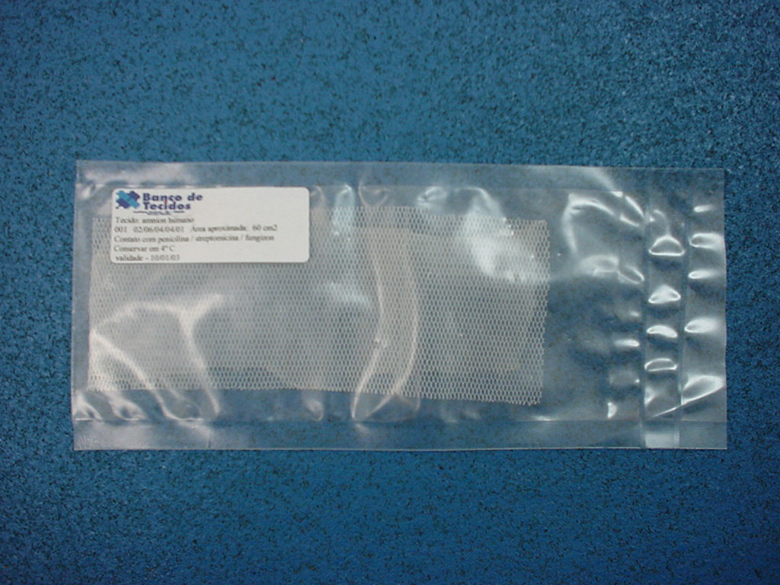
Tissue donation and the impact of tissue transplantation
Organ donation
Tissue Donation
1donor = benefit to 7 recipients
1 donor = benefit to 100s’ of recipients
¹ 2.5 million tissue transplants in the US/year ² 171,456 transplants in Europe + Latin America
htpps://Donatelife.net/donation/organs/tissue-donation – accessed Nov 2024
https://www.edqm.eu/en/newsletter-transplant - EUROCET - European Network of Competent Authorities for Tissues and Cells - 2023 - accessed Nov 2024
Notes:
Mention thousands of transplant take place / year

Slide 9
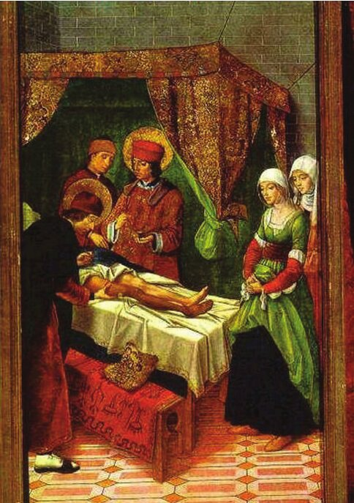
What is different - from donation to utilization

Slide 10
What is different - from donation to utilization
Donated tissues - “life cycle” peculiarities

Slide 11
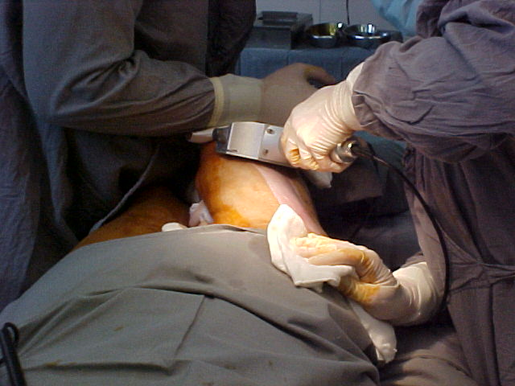
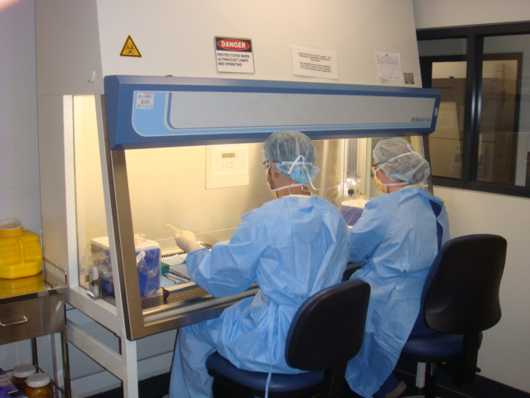
What is different - from donation to utilization
Donated tissues can be also retrieved by competent technicians
Donated tissues are usually transported to different facilities in the same area or country of collection for further processing
Most donated tissues will be further manufactured, usually within “controlled” environments
(note: variable requirements)
Processing may include diverse manipulation steps such as: cleaning, cutting, de-cellularization, de-mineralization, preservation (e.g. lyophilization, freezing, controlled rate freezing) and
bio-burden reduction (e.g. exposure to antibiotics, terminal sterilization) (note: potential changes in quality, safety and efficacy)
Notes:
Mention different resulting cell content, viability and changes in tissue properties depending

Slide 12
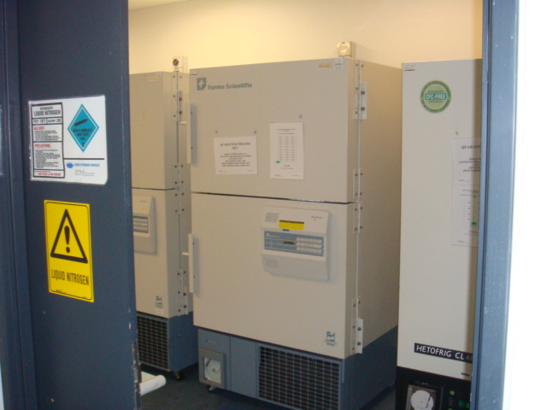
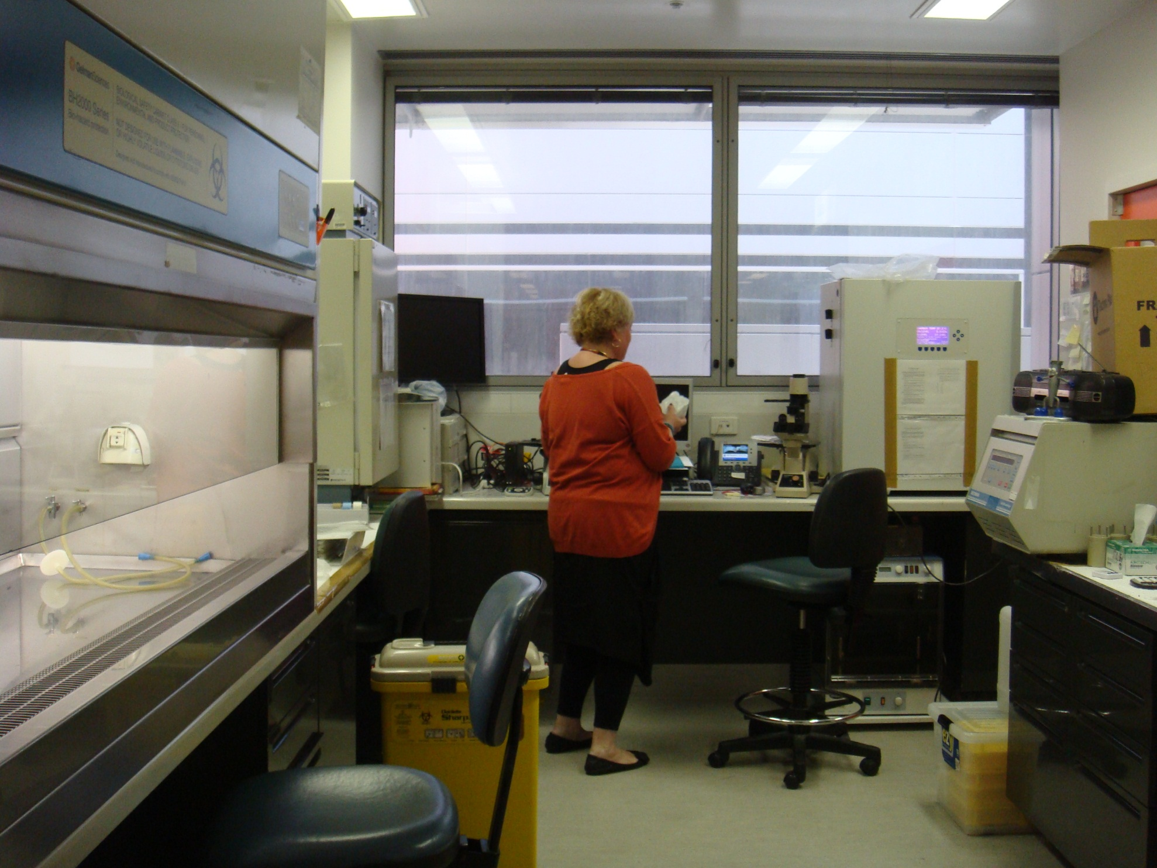
What is different - from donation to utilization
Unprocessed or processed tissues can be maintained under appropriate storage conditions, or “banked”, for longer periods at the processing facilities
(note: pending process & packaging ~ 2-4 years / corneas ~30days in culture medium)
Storage time allows for increased quality controls and safety assurance
Stored tissues may be distributed for transplantation from the tissue banks at different times, and as needed, within the assigned product lifespan
(note: waiting lists?, emergency resources)
Notes:
Mention different resulting cell content, viability and changes in tissue properties depending of process / Mention no need for wait lists as ‘stocks’ may be created and tissues available when needed

Slide 13
What is different - from donation to utilization
Processed tissues can, and do ‘travel’
…a lot

Slide 14
What is different - from donation to utilization
Tissue transplants travel frequently within national borders
Increasingly, the insufficiency of locally sourced tissues to supply demand foments the movement of tissue transplants across international borders (importation / exportation) (note: commercial players)
Unprocessed tissue may also be exported to a neighboring or a distant country for further manufacturing
Skin, bones and tissue for sale: How the dead are being used for grisly trade in human body parts
The Slovaks export cadaver parts to the Germans; the Germans export finished products to South Korea and the U.S.; the South Koreans to Mexico; the U.S. to more than 30 countries
Kate Wilson, Vlad Lavrov, Martina Keller, Thomas Maier and Gerard Ryle http://www.dailymail.co.uk July, 2012 (RTI )
Tissue transplants may remain stored under the custody of a secondary distributor, or in consignment at different medical or dental facilities, in the same country of manufacturing, or in a number of other countries
Notes:
In AU ~30% of transplanted tissues come from overseas // “Good news” – available tissues / ‘Bad news – excessive profit margins impacting on fair access

Slide 15
What is different - from donation to utilization
Tissue transplants are used by
multiple surgical specialties and teams,
and
in multiple indications

Slide 16
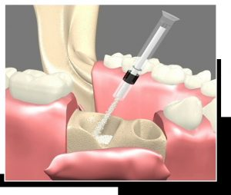
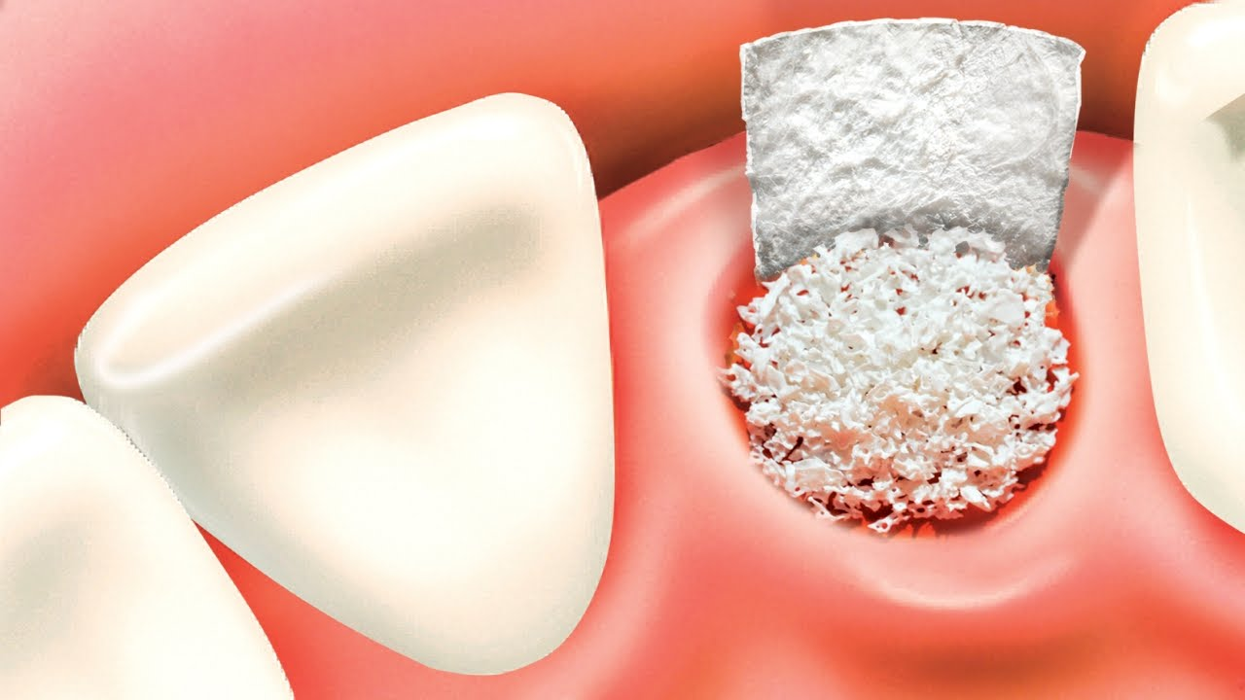
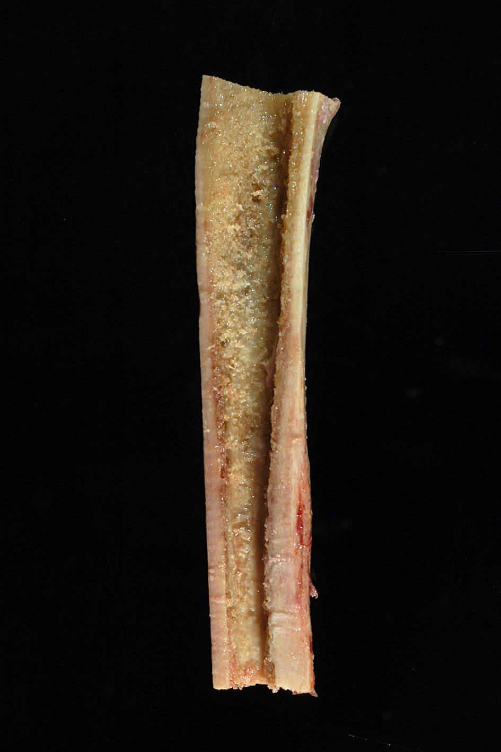
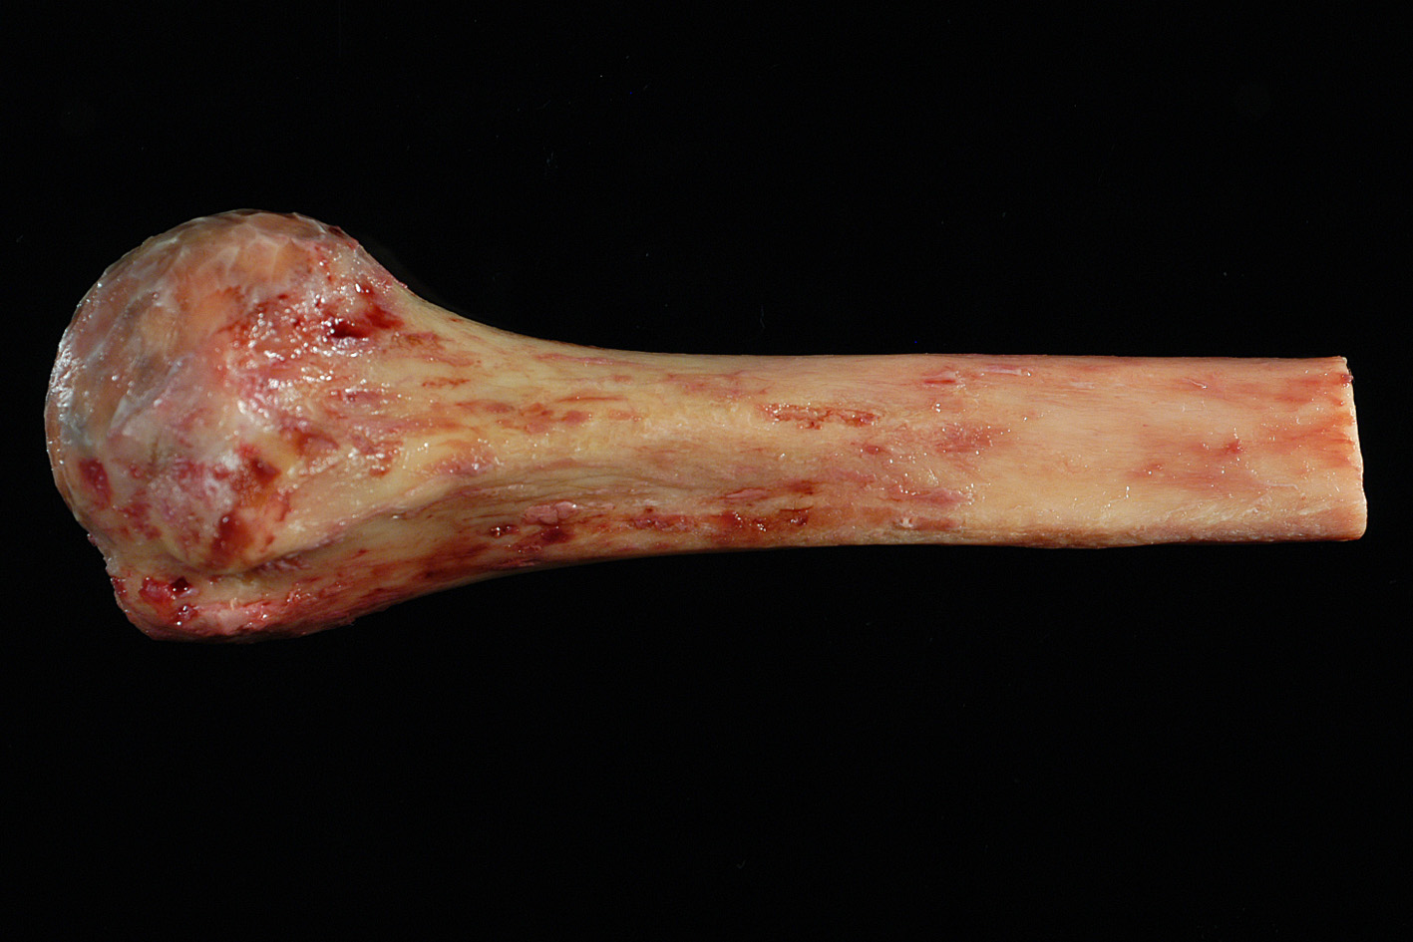

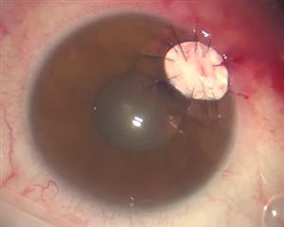
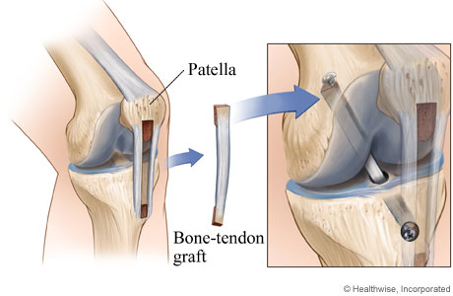
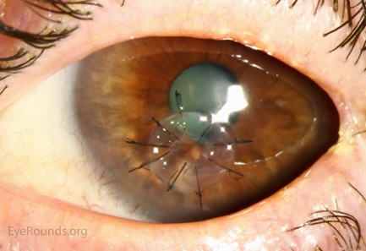
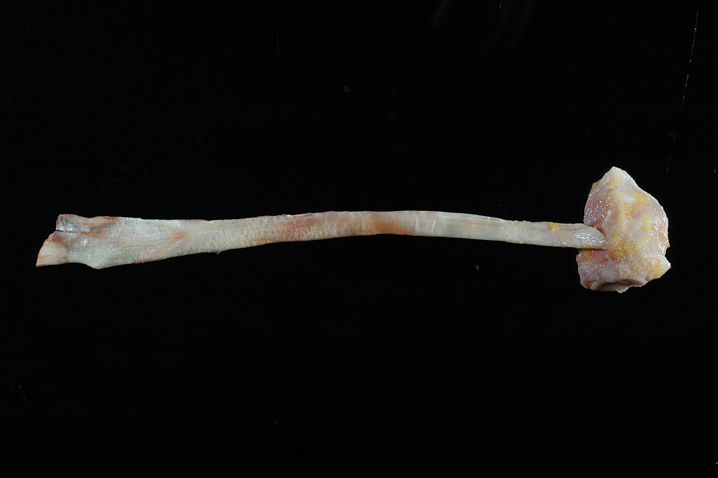
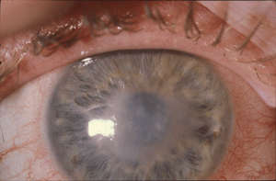
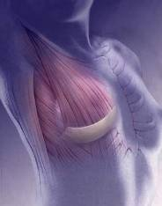
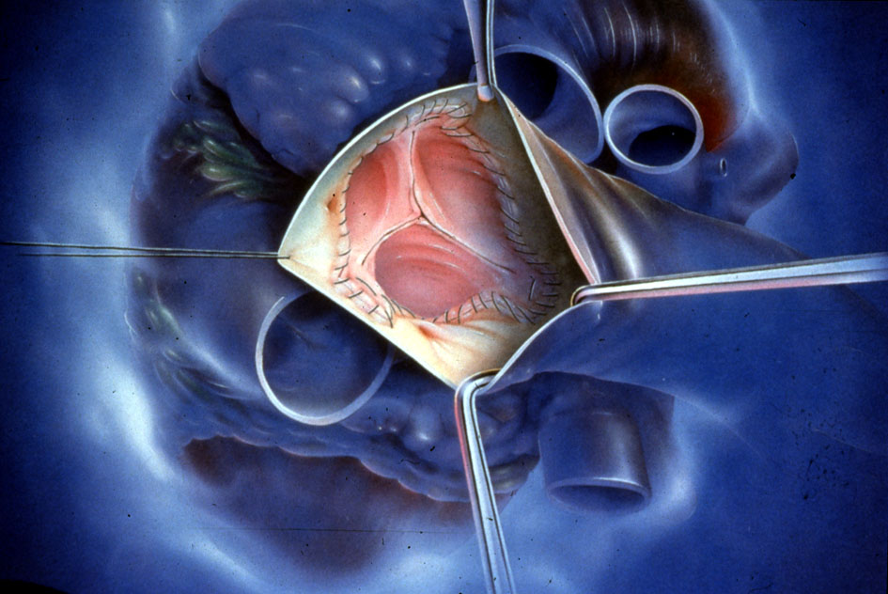
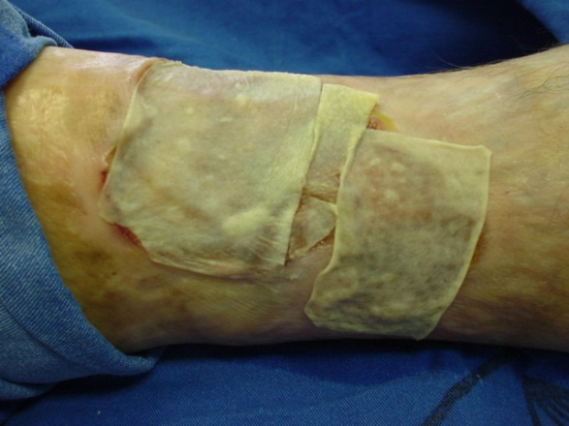

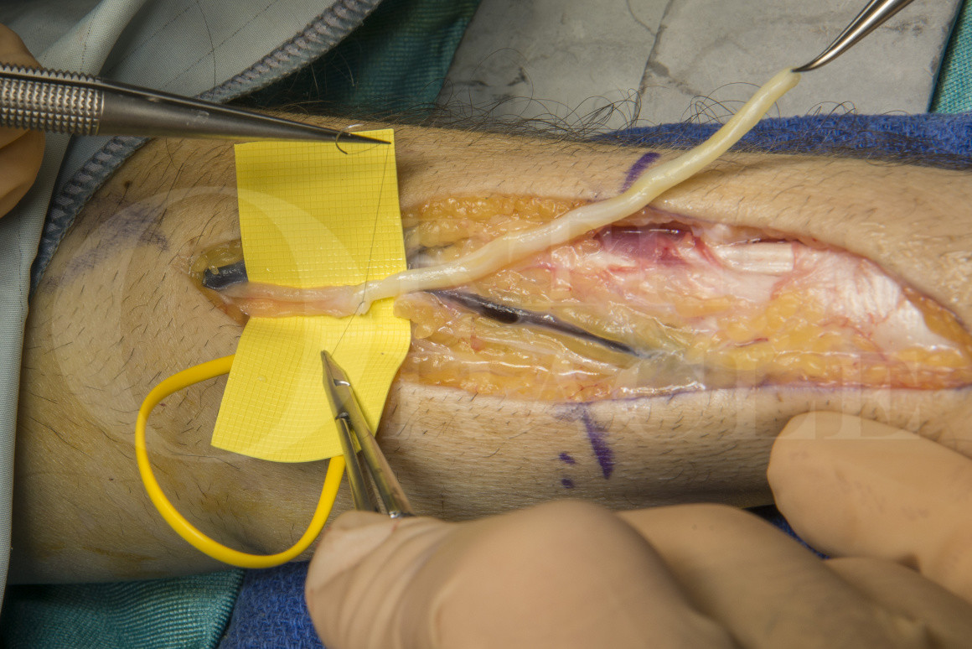
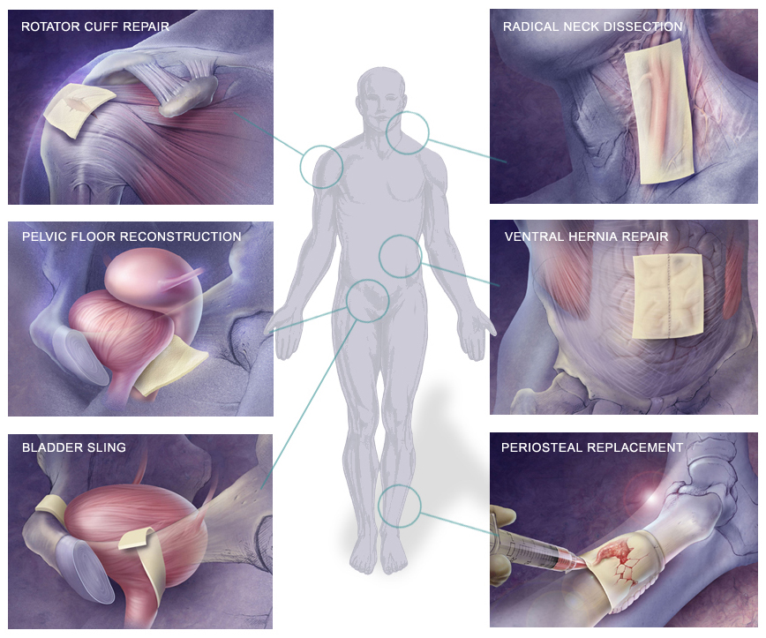
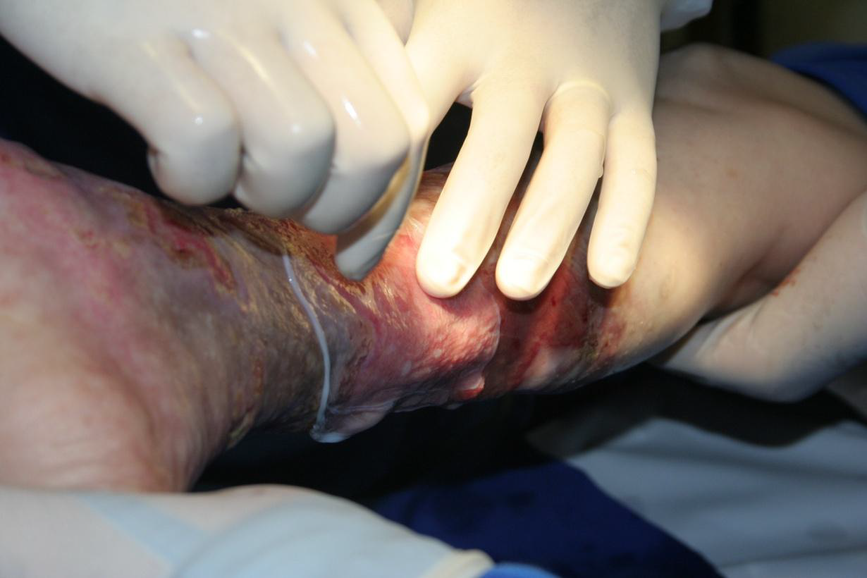
What is different - from donation to utilization
Orthopedic -trauma, spinal, cancer, sports, congenital
Dental surgery – implants, cranio-facial
Plastic surgery - bone loss, soft tissue repairs, burns
Dermatology – chronic wounds, soft contour restauration
Gynecology - breast reconstruction, pelvic floor repair
Ophthalmology – corneal transplants; trauma repair
Cardiovascular – valve acquired and congenital malformations, re-vascularization
Neurosurgery – re-innervation, cranial vault reconstructions
General surgery – abdominal reinforcement, soft tissue repair

Slide 17
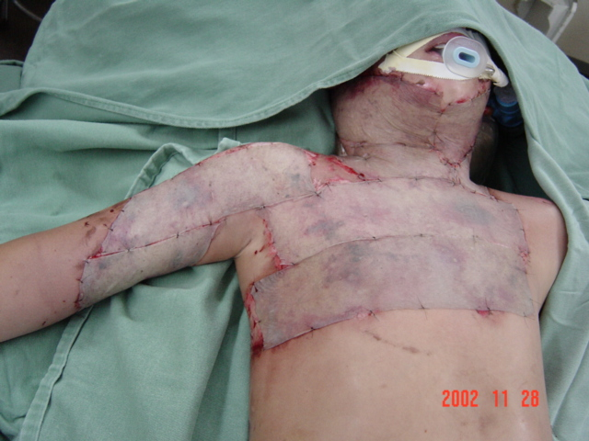
What is different - from donation to utilization
Blessing no.4 - ease of use
Immunological ‘cross-match’ or post transplant immunotherapy are not required in tissue transplantation
= expanded utilization
The techniques used in transplantation are the same as in ‘autologous tissue’ use
= no specific training or qualifications required (note: corneal transplantation)
No special hospital infrastructure is required for transplantation
= i.e. no need for ICUs, ‘fancy’ surgical settings or equipment

Slide 18
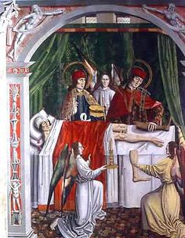
What happens less...
and the consequences

Slide 19
What happens less...and the consequences
The benefits of tissue transplantation are less recognized

Slide 20
What happens less...and the consequences
The risks of tissue transplantation are less recognized

Slide 21
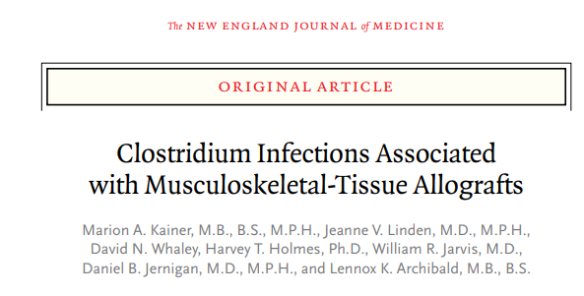
What happens less...and the consequences
Less awareness to extent and impact of the activity
= the benefits and the risks are underrated, with lesser engagement in policy and regulations
Tissue transplants may be treated as ‘commodities’ rather than human donated material
= commercialization inroads, with potential increase in costs generating further imbalance to access
The data collection on the activity is usually at high level only, of national or regional scope, via non comparable or incomplete datasets
= an under-recognition of the scale of the donation & transplantation activity, of the demand and of the capacity of supply
N Engl J Med 2004; 350:2564-71
Limited follow-up of transplantation outcomes
= low level of registration of utilization and/or identification of adverse events (except corneas)
“...because clinicians presume that allografts are sterile, allografts are not usually considered a potential source of infection”
Notes:
Falar de tissue dumping aqui

Slide 22
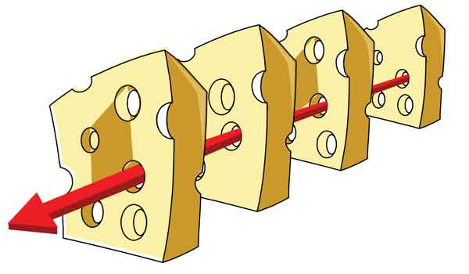
What happens less...and the consequences
There are no global minimal agreed standards on quality, safety and efficacy
= variable quality and safety standards in donor screening and manufacturing (and storage)
The standards and oversight of quality, safety and efficacy for exported / imported products are inexistent or ill-defined
= potential added gaps in biovigilance capacity
Donor screening
Processing
Donor & grafts data
review
Testing
Bad news: process controls may fail!
Donated tissue
Unsafe or poor
quality grafts
distributed
Notes:
Falar de tissue dumping aqui

Slide 23
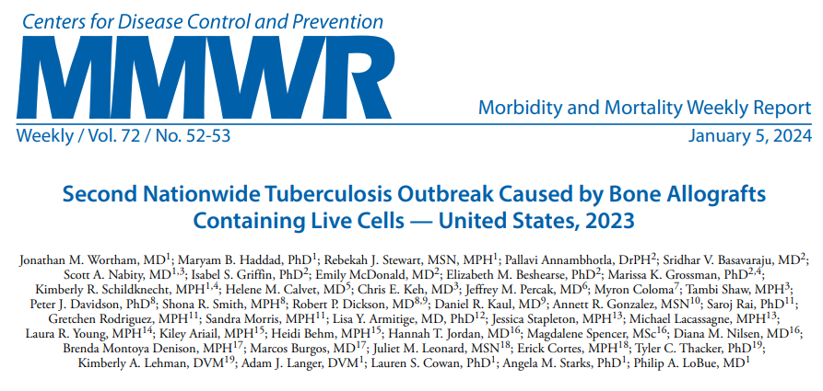
What happens less...and the consequences
Tissues from same donor may be at varied places and used at varied times, and by multiple surgeons
= lag in identification and notification of adverse events
Tissue banks / distributors may use proprietary product denominations & coding systems
= non harmonized product identification, language discrepancies, non standard labelling
There can be hardship in determining origin, manufacturing and implantation of products from donor(s) to recipients
= limited capacity of national and international traceability and product re-call
Notes:
Because is an underrated activity, without many registries or follow-up...

Slide 24
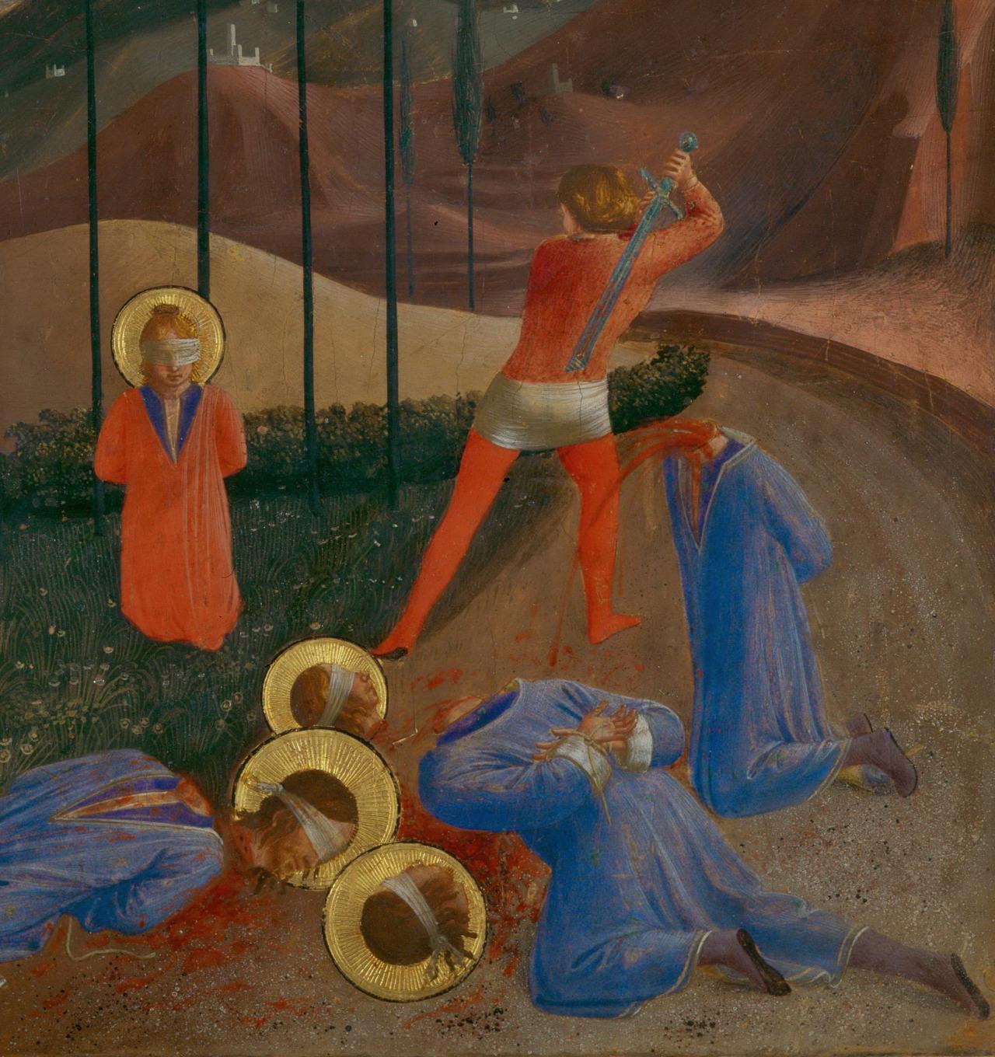
Thank you!

