Slide 1
Ethics, traceability and biovigilance of Medical Products of Human Origin
Recommendations from Forum 25
Lisbon, 2019
Timothy Pruett, MD
University of Minnesota
Past Board Chair, ICCBBA

Slide 2
No conflicts of interest, no off-label discussions.
Disclosure: Kamada advisory board for anti-CMV use

Slide 3
Why ISBT 128: and what is ICCBBA?
ONCE UPON A TIME (in 1994)….The International Council for Commonality in Blood Banking Automation (ICCBBA) was established.

Slide 4
ICCBBA came into being, for the need of automation in blood use
1975: Committee for Commonality in Blood Banking Automation (CCBBA) was established by NHLBI contract with the Am Blood Commission. A labeling code was created and adopted by Am Red Cross. It became known as Codabar (about 1980). 1985, FDA recognized the code for blood labeling.
It had a flaw: there was no formal mechanism to maintain and update ABC Codabar. As blood processing changed, code modifications were haphazard and its utility diminished.
  AABB and ISBT created independent committees to “fix” the code. In 1989, the committees collaborated and concluded that ABC Codabar could not be “fixed”.
New products continued to be introduced: the blood label describing “what’s in the Bag?” became increasingly inconsistent. The automation benefit decreased.
1990-93 ISBT, AABB and ARC met and a new code (ISBT 128) was developed. The societies proposed that a permanent office be created for maintenance of the standard and code currency. In 1993, a draft business plan for CCBBA was created. The need for labeling consistency was accentuated by needs during the Gulf War.
Baxter provided 3 yr grant and US DOD issued contract for services allowing for the creation of International Council for Commonality in Blood Banking Automation (ICCBBA). An office with an Exec Director opened in Oct 1994 (25 years before Forum 25).
ICCBBA established Technical Advisory Groups (TAGs) for different MPHO types to maintain currency.
2013: ISBT 128 was renamed the Information Standard for Blood and Transplant 128 (the ISO 7 bit character set with 128 characters) in recognition of the wide spectrum of human products used in therapy.

Slide 5
What elements need label inclusion?
MPHO is an individual and peculiar gift.
Medical devices are linked through manufacturing lot numbers. The coding requirements for manufacturing and MPHO differ:
There is a single donation event from an individual: multiple different products for multiple recipients can come from a single donation. Donation identification.
  Each donation event (living or deceased) differs, in quality and risk of the product.
    MPHO can be highly beneficial, changes inconsistently be age, health, nutrition etc. Some donated products may be of insufficient quality for use in a person/recipient.
    All MPHO carry the risk that a disease from the donor may be transmitted to a recipient.
The MPHO labeling should facilitate maximal recipient benefit and efficient/safe use.
The major stakeholders in MPHO use, distribution, storage and safe use.
  Recipient: Correct product for the recipient clinical need. The implanting surgeon: What (how much) MPHO is needed and any processes required prior to use?
  Systems: Product acquisition, processing, distribution, inventory management, availability and use of MPHO.
  Regulators: Verification of product identity, for licensing, oversight of transport, distribution and the biovigilance response to risk events and reported adverse outcomes.

Slide 6
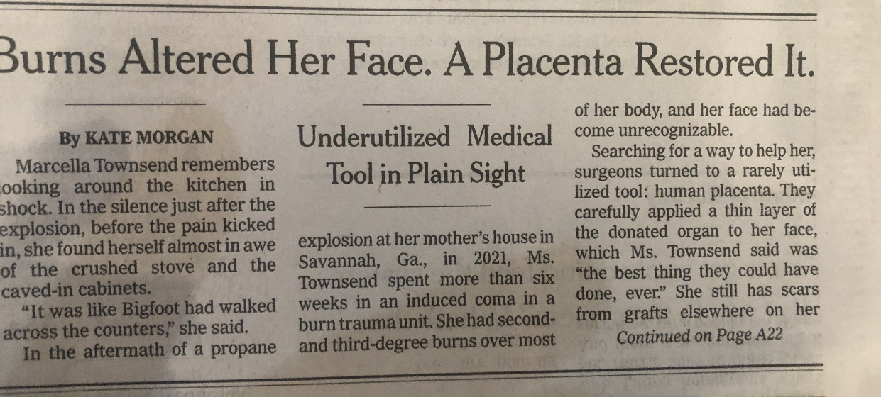
The benefits and risks in the transplantation of amniotic tissues.
10 Oct 2024: New York Times
Clinical Infectious Diseases® 2017;65(7):1152–8

Slide 7
Forum 25 was planned with the recognition that MPHO diversity was expanding and needs of the stakeholders were evolving and in flux.

Slide 8
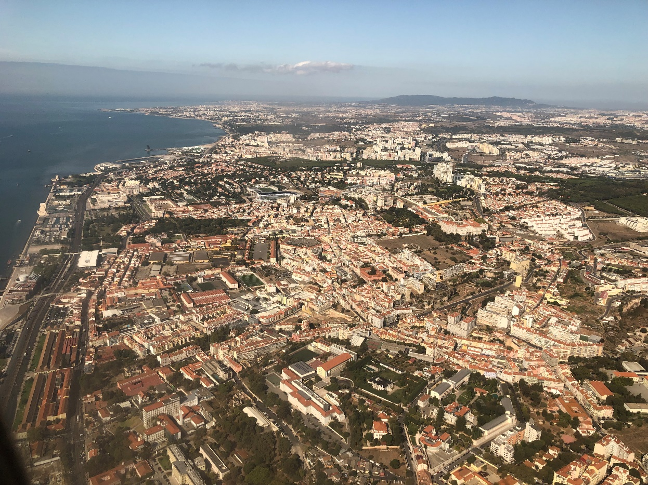
Forum 25, Lisbon 2019: celebrating 25 years of ICCBBA (est. 1994) and the ISBT128 standard
Planned as a fun, celebration
Existential question existed: why does ICCBBA exist? Why isn’t ISBT 128 used universally?
Was there still a need for uniform, standardized coding of not only blood, but the other diverse medical products of human origin (MPHO)?

Slide 9
Keynote Talk: Luc Noel (WHO)
Started with the incredible benefit from blood, moved through the story of the benefits, diversity, risks/harms that occur with the use of MPHO
Governmental authorities play a key role ensuring product safety.
Globalization of MPHO use is real.
WHO has made efforts to address MPHO safety, availability and ethical practice and equity.
  Multiple programs on blood availability and safety
  WHA resolutions on donation and txp
  Project NOTIFY (V&S).
  SONG project. Uniform language and source identification.

Slide 10
In the 25th year of ICCBBA management of ISBT 128
ISBT 128 wasn’t just for blood. Technology advances were creating new products.
  MPHO types had expanded and were increasingly shipped across national borders, challenging effective, safe use and oversight.
    MPHO: ISBT 128 exist for:
      Blood and derivative products
      Minimally manipulated, homologous use tissues: bone in many shapes/forms, tendon/ligament, skin, vascular, fat, nerve, cartilage, trachea
      Ocular: cornea (and its layers), but also sclera, other eye elements, serum eye drops
      Cells: ART (semen, ova, blastocysts…), but expanding numbers of MSC, gene, lymphocytes modified in vitro for tumor and infection. Indications for cell therapy are expanding rapidly.
      Organoids: islets, others to come.
      Organs: kidney, liver, heart, lung, intestine, uterus, extremity
      Milk for infants
      Microbiota; gut repopulation
Forum 25 topics (2019): challenges of traceability, unregulated activities/patient safety, future challenges (genetic), V&S of MPHO, Informatics and technology

Slide 11
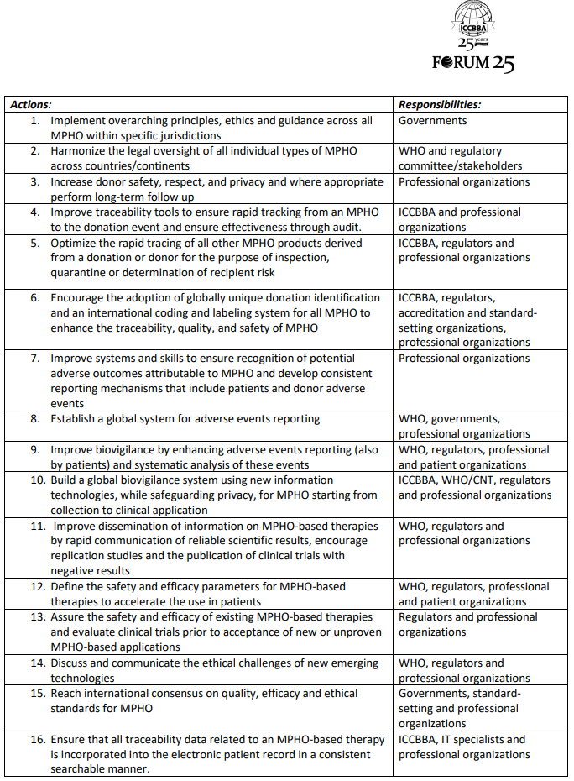
Bull World Health Organ 2021;99:907–909 doi: 10.2471/BLT.21.285484.

Slide 12
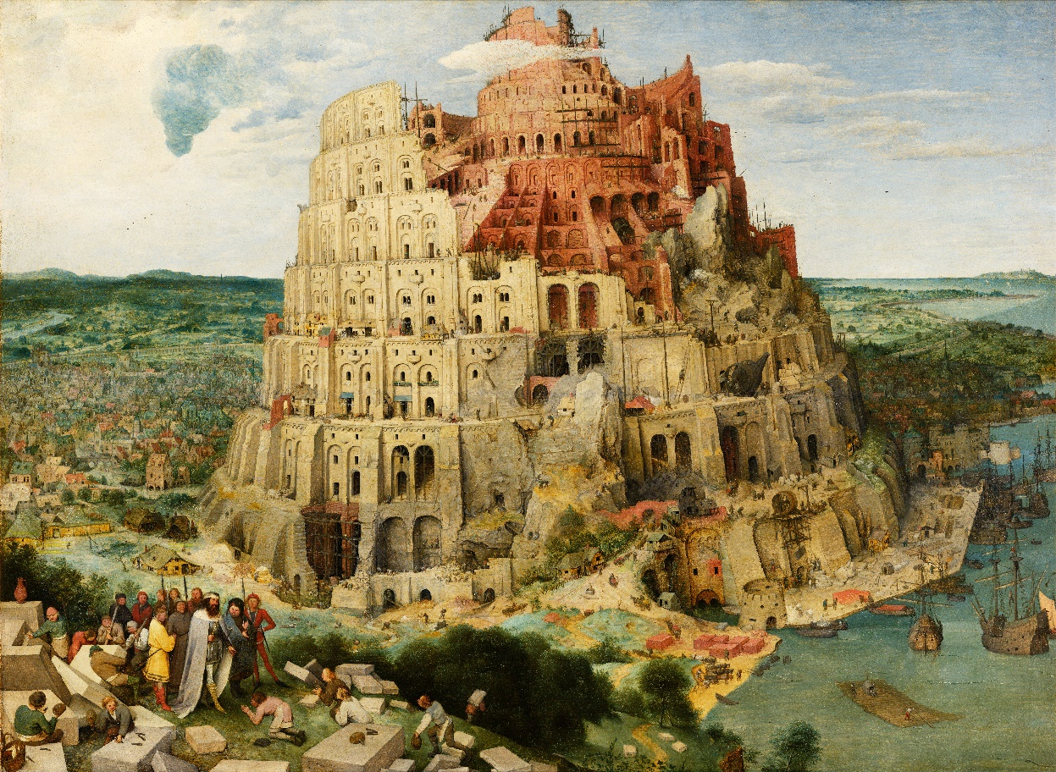
Common language is critical for goal achievement.
The Tower of Babel
In early times, all mankind spoke a single language and they decided to work together and build a tower to the heavens. It was working.
“And the LORD said, "Look, they are one people, and they have all one language, and this is only the beginning of what they will do; nothing that they propose to do will now be impossible for them.” Gen. 11:6 (NRSV)
Yahweh confused their language, by creating a lack of communication, the Tower project failed.
The people scattered and formed tribes and nations.
Global vs national/regional healthcare.
For the sake of efficiency, appropriate use, and safety for global MPHO use; a common language needs to created.
Each stakeholder has a different need. Biovigilance systems require a variety of elements not provided by supply chain codes.
Pieter Brueghel the Elder

Slide 13
Efforts to meet MPHO biovigilance issues, 2024
Wide-sweeping 2024 Regulation (EU) on standards of quality and safety for substances of human origin intended for human application, to be enacted in future: https://eur-ex.europa.eu/legal-content/
US experienced multiple deaths after use of M Tuberculosis transmission through bone tissue products, leading to a just completed Biovigilance Gap Analysis for US tissue. https://www.hhs.gov/sites/default/files/acbtsa-gap-analysis-tissue-biovigilance-subcommittee-report.pdf
MPHO use continues to expand globally with products and tissues being shipped across national boundaries. Especially for corneas and human tissues.
  CDC notes that tissues transported across national boundaries are very hard to track.
Each nation is charged with ensuring MPHO quality and safety. There is a role for WHO coordination of biovigilance efforts across borders. Especially as so many products cross jurisdictions.

Slide 14
Thank you.

Slide 16
In 2024, the coding of therapeutic products obtained from human donation (MPHO, SOHO) remains decentralized and confined to different products (tribes).
Stakeholders involved in the use of these disparate MPHO continue to have diverse opinions and needs.
Some

