Slide 1


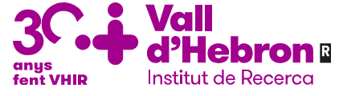
emerging techniques and applications concerning MPHO
Joaquim Vives, PhD
Banc de Sang i Teixits
Vall d’Hebron Institut de Recerca
Universitat Autònoma de Barcelona
Notes:
MPHO: Medicinal Products of Human Origin although broader to ATMP, will be treated as ATMP given the tend in converging Quality standards and Regulations.
Here the presentations can be a mix of science-based therapeutic imagination and back-to-earth challenges. The audience should be allowed to ‘think big’ but without forgetting the fundamentals of safety and efficacy and the associated regulatory frameworks.
Some of the audience will not be familiar with the therapeutic areas nor the techniques so tailor your messages accordingly. The regulators in the audience should see the session as an “express” horizon-scanning exercise, even for those regions where advanced therapies will take longer to reach patients. The audience at large should also go away knowing that there are concerted international efforts taking place to align regulations and regulators around the world to facilitate faster authorization processes without sacrificing rigour.

Slide 2
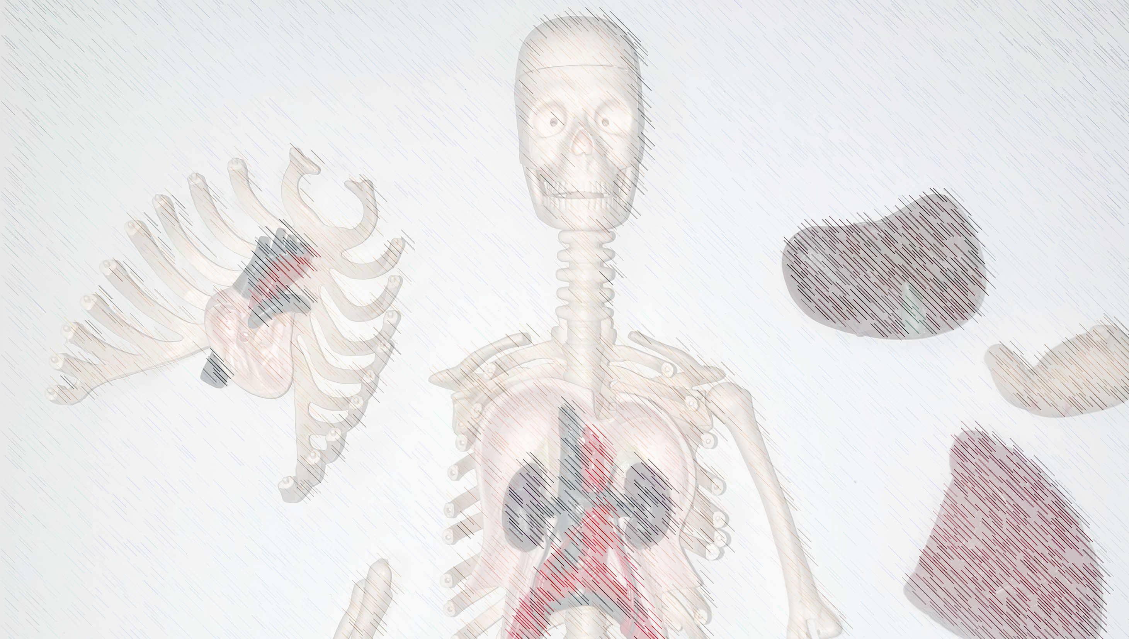

1= 8+200

Slide 3


DONATION
tissues
cells
cellular products
unmanipulated
minimally processed
disaggregated
unmanipulated
minimally manipulated
substantially manipulated
conditioned medium
extracellular vesicles
purified proteins
alone or in combination
custom shape (3D bioprinting tecnologies)
fresh or matured ex vivo
simple to complex formulations (synthetic/natural ingredients)
THERAPY
Notes:
Realising the value chain from donation to transplantation. Donations are used directly or further processed,

Slide 4
DONATION
tissues
cells
cellular products
TRACEABILITY
unmanipulated
minimally processed
disaggregated
unmanipulated
minimally manipulated
substantially manipulated
conditioned medium
extracellular vesicles
purified proteins
alone or in combination
custom shape (3D bioprinting tecnologies)
fresh or matured ex vivo
simple to complex formulations (synthetic/natural ingredients)
THERAPY
Notes:
Realising the value chain from donation to transplantation. Donations are used directly or further processed,

Slide 5
Delgadillo et al (2023) Cytotherapy 25, 1259
Notes:
Realising the value chain from donation to transplantation. Donations are used directly or further processed.
Importance of traceability

Slide 6
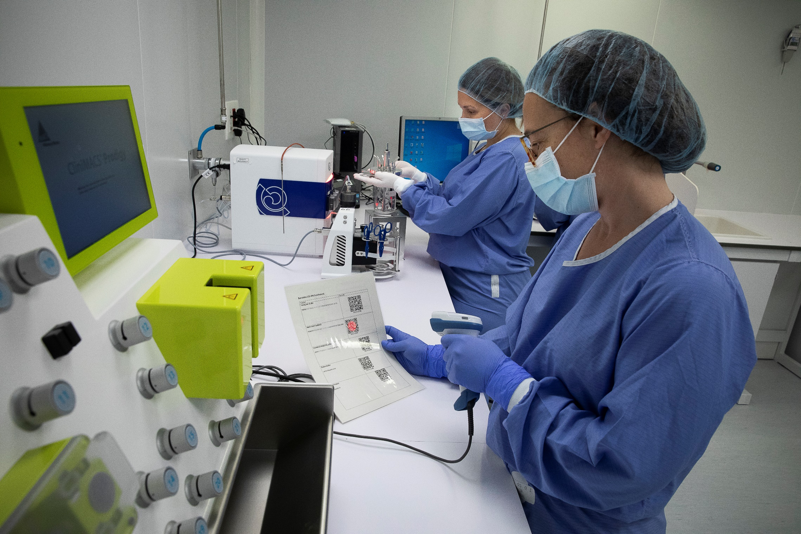

Slide 7
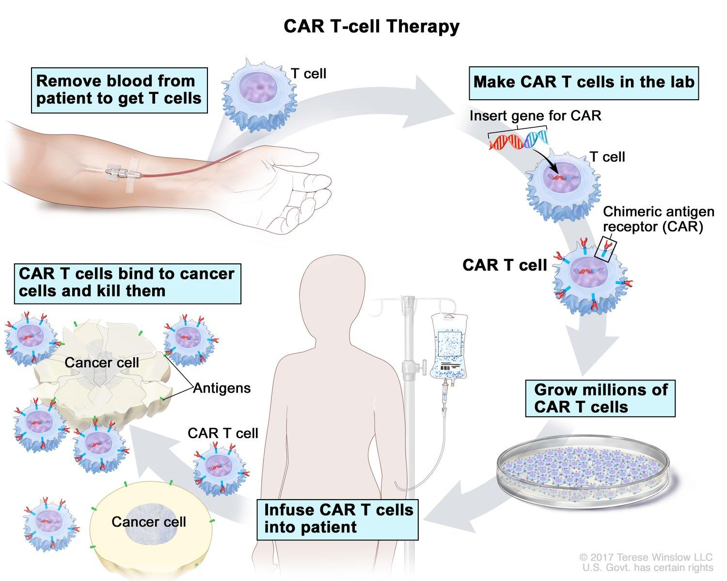
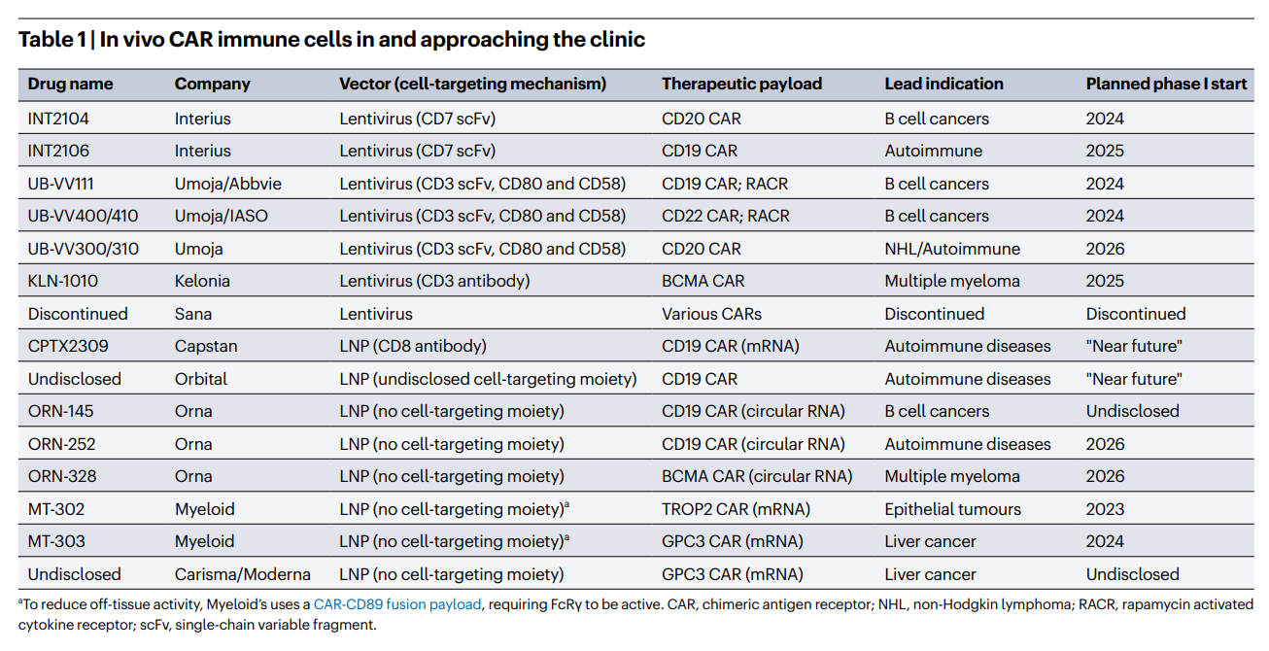
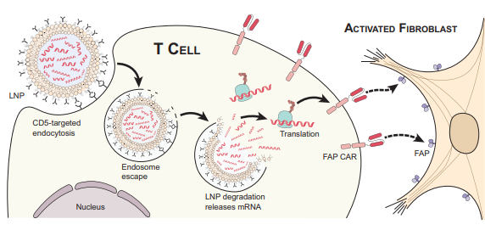
CAR-T: ex vivo vs. in vivo
Rurik et al (2022) Science 375, 91
Mullard (2024) Nature Rev Drug Discovery 23, 727
Notes:
Realising the value chain from donation to transplantation. Donations are used directly or further processed,

Slide 8
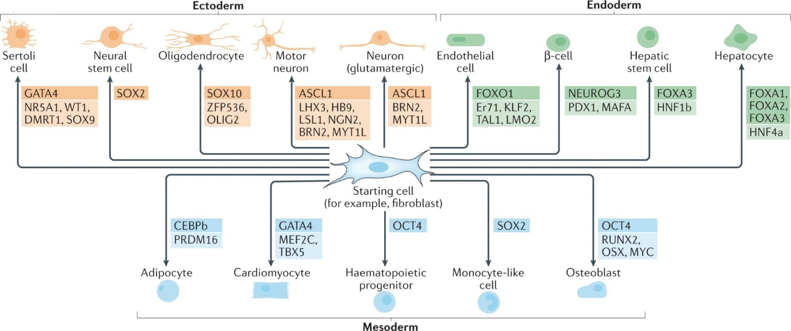
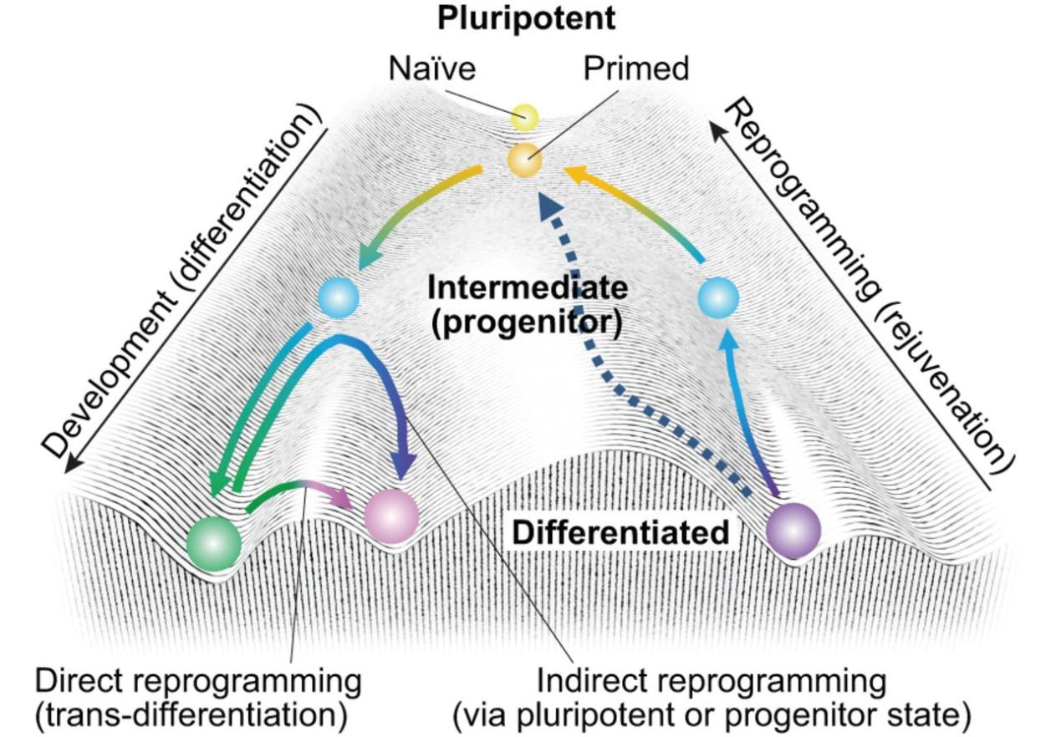
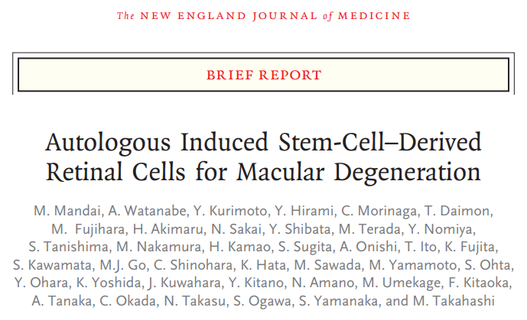
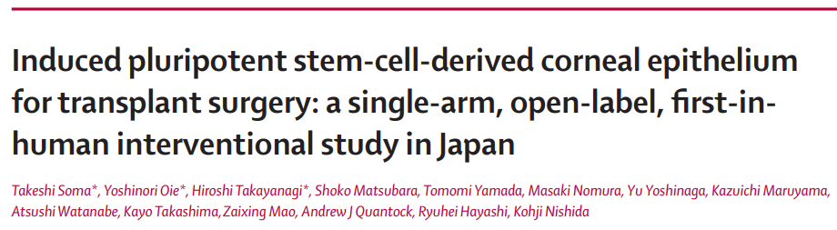
Wang et al (2021) Nat Rev Mol Cell Biol 22, 410
Takahashi & Yamanaka (2015) Development 142:3274-3285
Notes:
Realising the value chain from donation to transplantation. Donations are used directly or further processed,

Slide 9
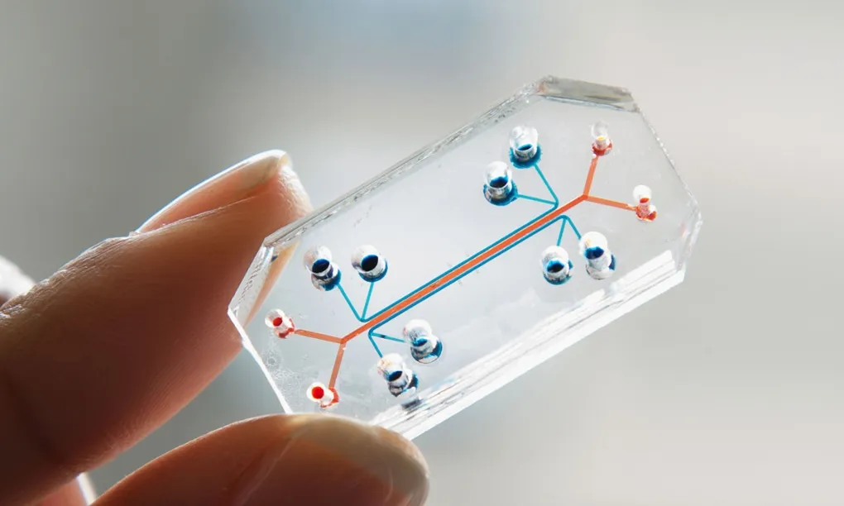


Slide 10

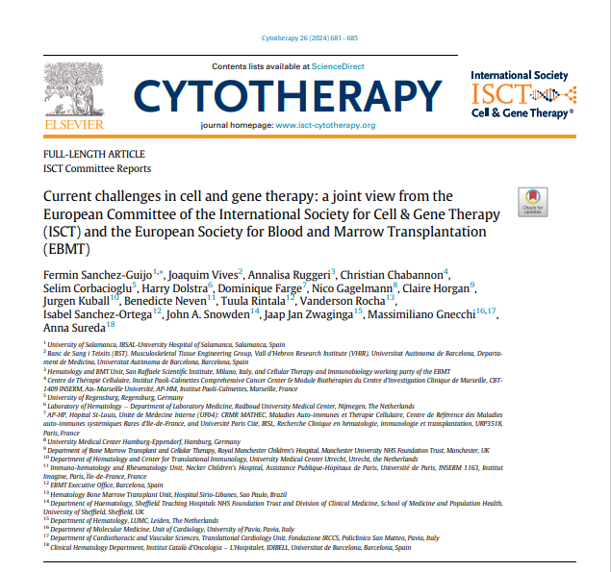

moonshots
Data Ecosystem for Real-World Evidence
Quality Standards for Manufacturing & Hospital Exemption
Equitable & Outcome-based Reimbursement Models
Collaborative Networks for Academic Manufacturing
Public-Private Partnerships to Accelerate Developments
Workforce Training Program
Public Awareness of Unproven Therapies
Improve Patient Access & Innovation
challenges
Notes:
From our ongoing work at ISCT&EBMT, several key moonshots and research challenges emerge. These proposals aim to address gaps in infrastructure, standardization, access, and workforce development, ultimately accelerating the impact of advanced therapy medicinal products (ATMPs) across Europe.

Slide 11
Establish a Data Ecosystem
Moonshot 1
  Create a comprehensive, unified data ecosystem that captures real-world data from all MPHO applications across Europe, beyond hematologic and bone marrow therapies. This ecosystem would enable evidence-based policy decisions, track efficacy and safety in diverse indications, and provide rapid feedback loops to improve patient outcomes.
Challenges
  Integrate diverse registries and ensure interoperability across national and institutional databases with a common terminology.
  Address privacy, ethical, and security concerns for handling patient data across borders.
  Secure consistent funding and collaboration across countries to manage infrastructure and data maintenance.

Slide 12
Harmonize Quality Standards
Moonshot 2
  Develop a Europe-wide framework for ATMP production that aligns quality, safety, and efficacy standards between commercial and hospital exemption pathways, facilitating the production of locally manufactured, point-of-care therapies under stringent criteria.
Challenges
  Define and implement standardized quality benchmarks that accommodate academic centers and point-of-care manufacturing.
  Streamline regulatory oversight to support the flexibility of hospital exemption while ensuring robust data collection and adherence to quality metrics.
  Encourage governments to support academic and hospital-based facilities with the necessary resources to meet quality standards.

Slide 13
Implement Reimbursement Models
Moonshot 3
  Develop and adopt a Europe-wide, outcome-based reimbursement model that ensures equitable access to ATMPs, regardless of a patient’s location. This model would incentivize results, paying manufacturers based on patient outcomes and health improvements.
Challenges
  Gain consensus on outcome metrics and acceptable timeframes for evaluating patient responses.
  Coordinate with multiple national health agencies and payers to align reimbursement policies with this model.
  Design a transparent mechanism to track patient outcomes and distribute payments accordingly.

Slide 14
Academic Collaborative Networks
Moonshot 4
  Establish a robust network of academic and clinical centers across Europe capable of producing CAR-T cells and other cellular therapies. This network would allow for point-of-care manufacturing, reducing costs, and expanding patient access to therapies.
Challenges
  Secure initial funding and resources to build and equip manufacturing facilities at the regional level.
  Provide targeted training for clinicians and technicians to manage production in compliance with regulatory standards.
  Facilitate partnerships with the commercial sector to transfer technology, exchange expertise, and potentially co-develop new therapies.

Slide 15
Public-Private Partnerships
Moonshot 5
  Establish consortia that bridge the gap between academia, industry, and regulatory bodies to fast-track ATMP development and approval. These partnerships would pool resources, share intellectual property rights, and optimize early-stage research funding to expedite therapy pipelines.
Challenges
  Coordinate diverse stakeholders with varying interests, intellectual property concerns, and funding capacities.
  Ensure that public funding benefits patients directly and maintains transparency in decision-making and priority-setting.
  Standardize data sharing agreements and establish clear ownership rights, particularly for discoveries made within consortia.
  .

Slide 16
Create a Workforce Training Program
Moonshot 6
  Launch a pan-European training program for professionals in gene and cell therapy, spanning preclinical research, clinical trials, regulatory science, and advanced manufacturing. This program would address the critical shortage of trained professionals and provide equitable access to high-quality education across Europe.
Challenges
  Develop a curriculum that meets the needs of both academic and industry sectors, with hands-on training in ATMP production and regulatory compliance.
  Address disparities in training access by creating remote and hybrid learning modules, allowing professionals in underserved areas to participate.
  Foster collaboration between scientific societies, universities, and industry to co-fund and deliver training modules.
  .

Slide 17
Public Awareness & Regulatory Action
Moonshot 7
  Develop a Europe-wide initiative to educate patients and the public on the risks of unproven cellular therapies, empowering patients with accurate information and helping them differentiate between validated treatments and fraudulent ones.
Challenges
  Create multilingual educational materials and engage patient advocacy groups for widespread dissemination.
  Implement a robust system for monitoring and sanctioning clinics or entities offering unapproved therapies.
  Partner with regulatory agencies to build a “trusted source” platform listing all approved ATMP providers and therapies.

Slide 18
Improve Accessibility & Innovation
Moonshot 8
  Revamp European ATMP regulations to simplify the authorization processes, supporting rapid patient access while maintaining rigorous safety standards. This includes refining guidelines for hospital exemptions and enabling faster pathways for high-need patient populations.
Challenges
  Harmonize diverse regulatory requirements across Member States to facilitate more seamless market access.
  Balance innovation incentives with patient safety to foster responsible development and commercialization.
  Engage stakeholders early in the revision process to reflect broad input and minimize implementation delays.
  ..

Slide 19
Final remarks
These moonshots represent critical pathways to overcoming the obstacles facing cellular and gene therapy technologies in Europe.
By focusing on infrastructure, harmonization, equity, and education, Europe could lead globally in ATMP accessibility and innovation, creating transformative therapies for diseases with high unmet medical needs.
Notes:
From our ongoing work at ISCT&EBMT, several key moonshots and research challenges emerge. These proposals aim to address gaps in infrastructure, standardization, access, and workforce development, ultimately accelerating the impact of advanced therapy medicinal products (ATMPs) across Europe.

Slide 20

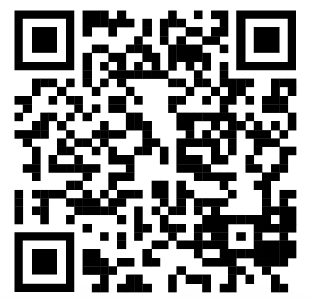



jvives@bst.cat

